Slide 1
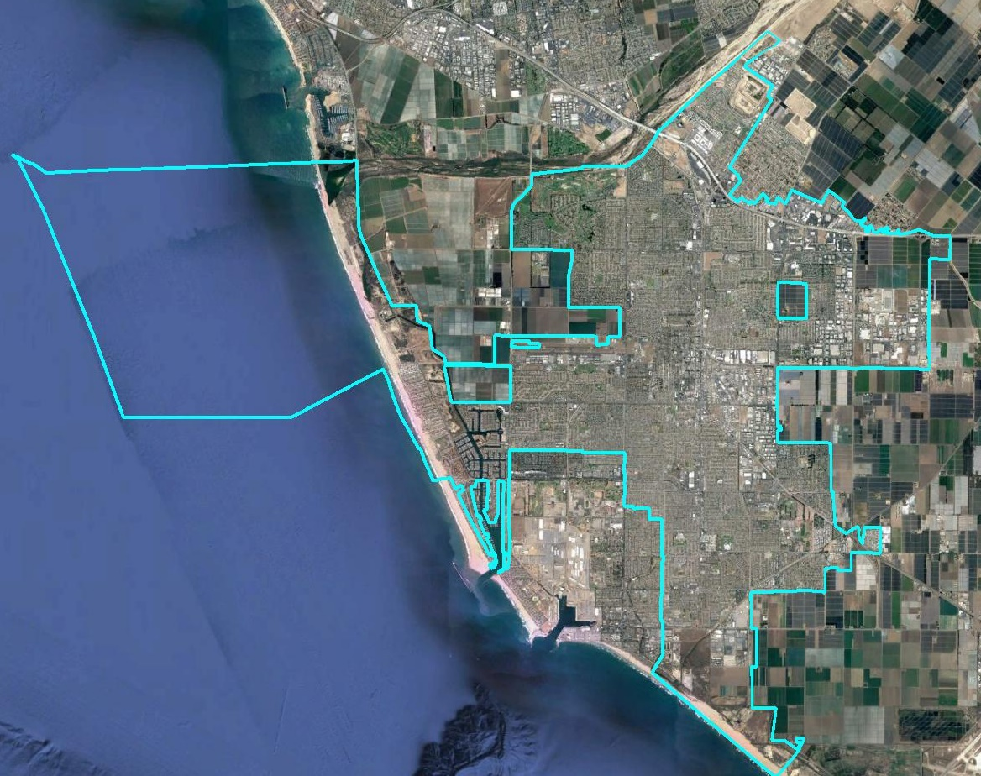
City of Oxnard Consideration of By-District Elections

Slide 2
Public Participation
City provided many avenues for public input:
South Oxnard forum
Online districting tool
Excel and Paper districting tools
Social media and traditional communications channels
Public Responded:
Good turnout at South Oxnard forum
72 maps submitted, with 59 drawn using the online tool, 3 using the Excel tool, and 10 using the PDF/paper map
Even counting just one of the 34 maps submitted by one person, and just one of the of 10 maps submitted by a 2nd resident, 17 residents submitted 30 maps!

Slide 3
Summary of Maps
72 Maps submitted
7 were withdrawn by the submitter (in favor of updated versions)
7 divided the city into only two or three districts
18 were not population balanced
1 did not contain contiguous districts
1 proposed a single district to be contained in a 6-district map
Legal Maps Submitted
13 four-district maps
20 six-district maps
4 eight-district maps
NDC added an additional 4-district and an additional 8-district map to round out the mix of options

Slide 4
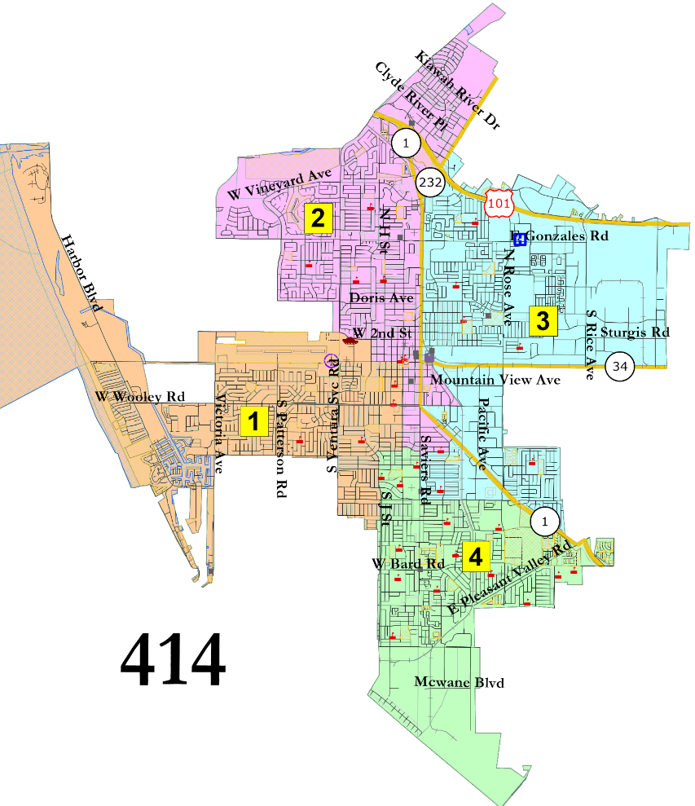
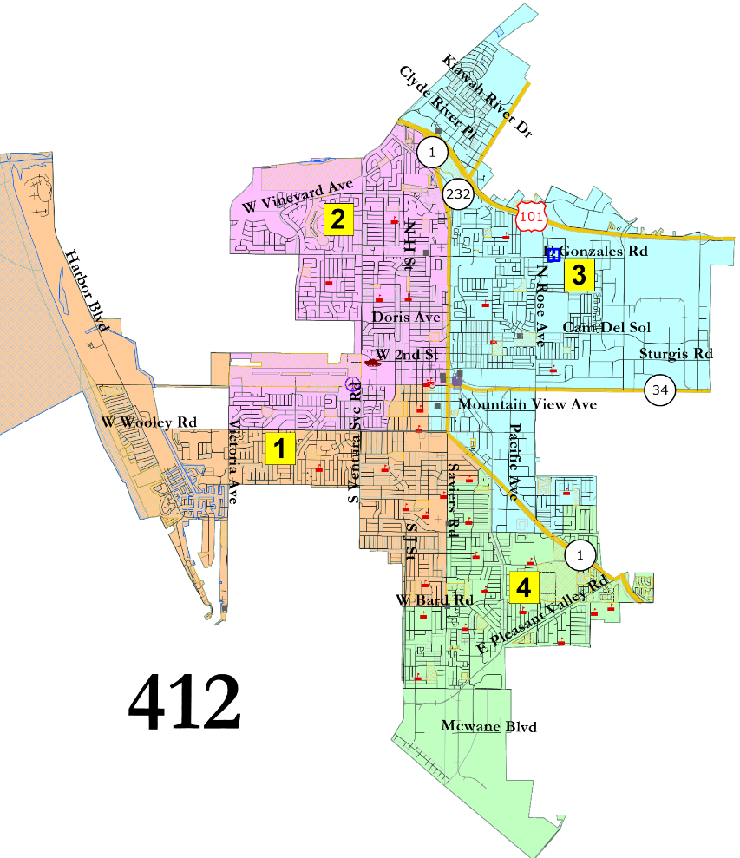
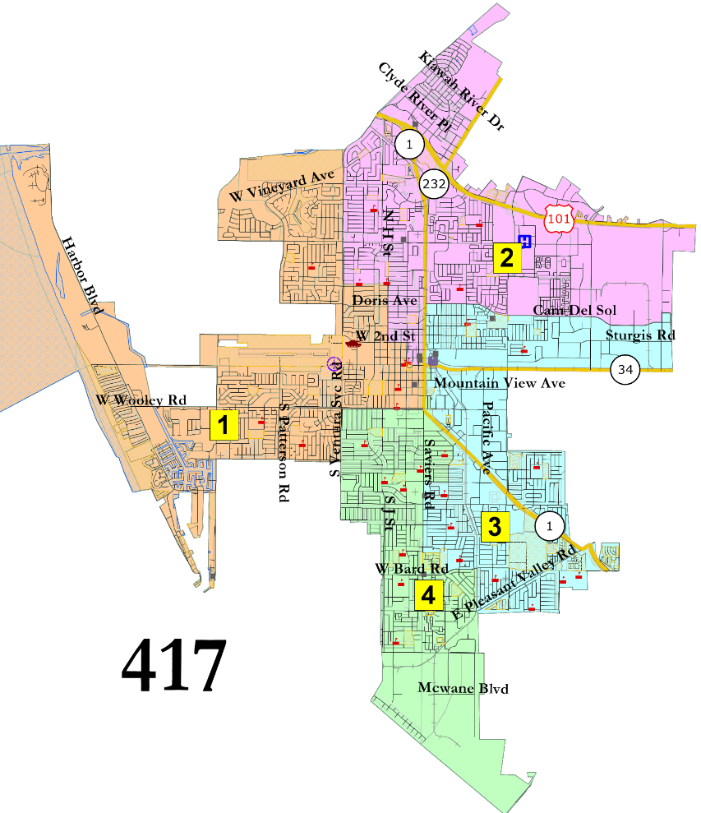
2 Districts in the North
Interactive Map

Slide 5
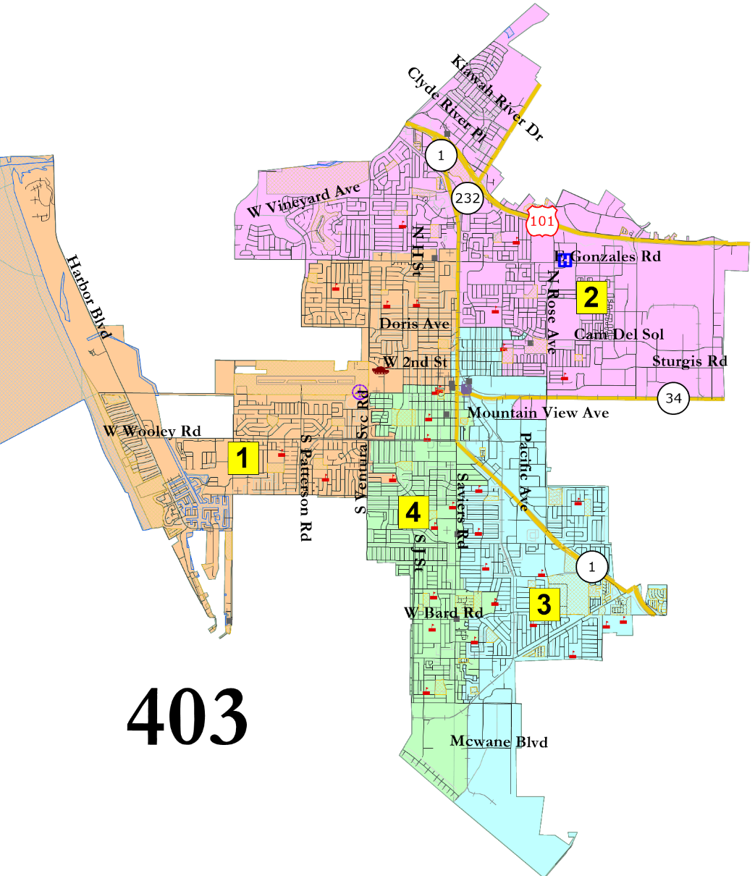
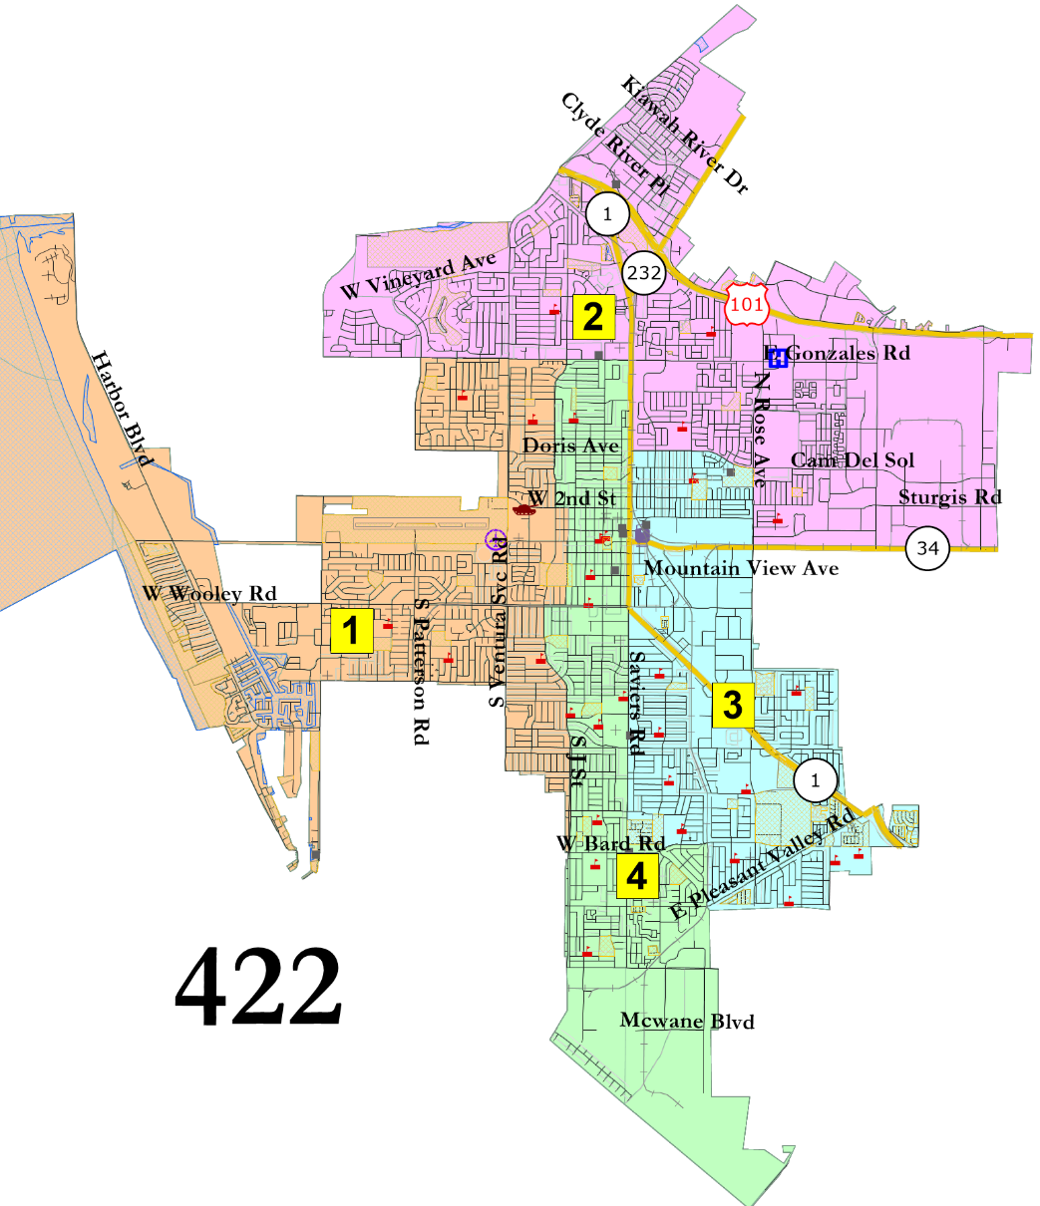
1 in North and 2 in South
Interactive Map

Slide 6
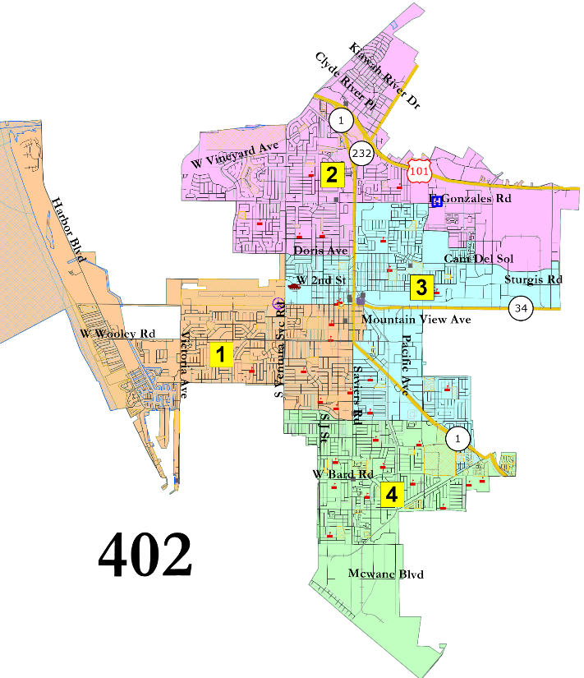
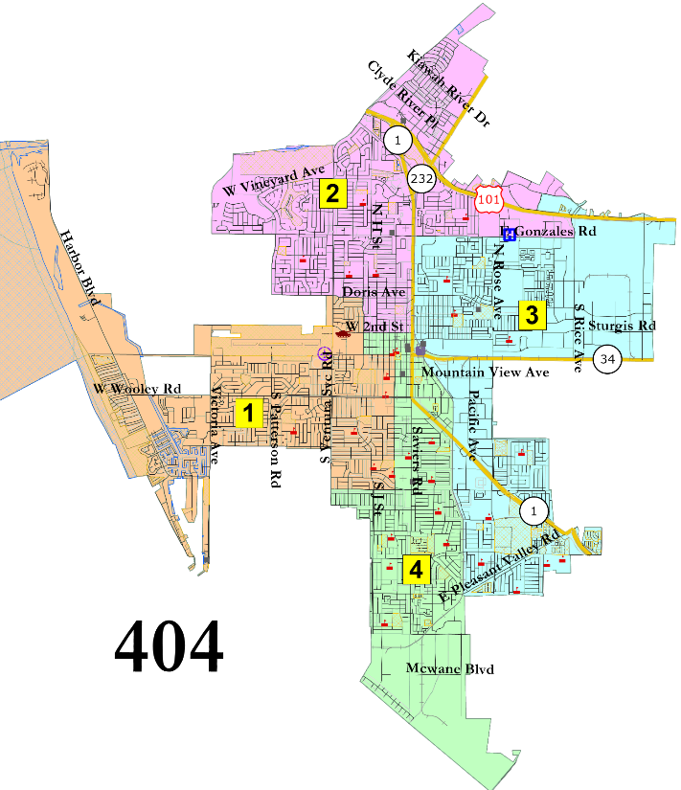
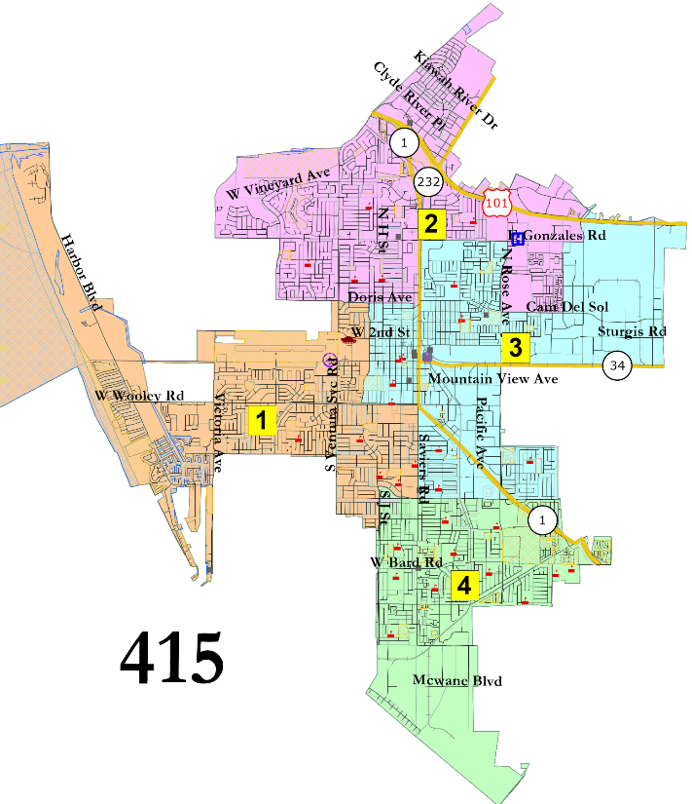
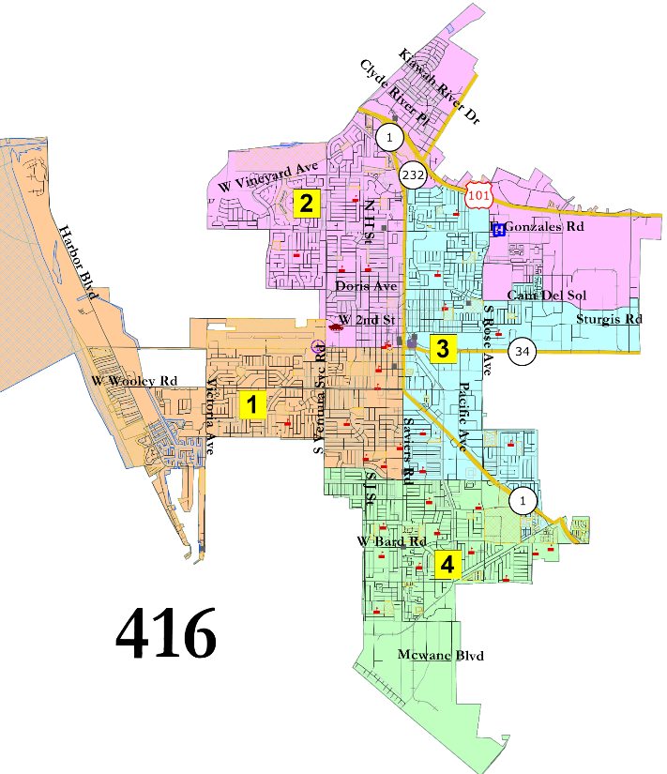
1 in North, 1 in South
Interactive Map

Slide 7
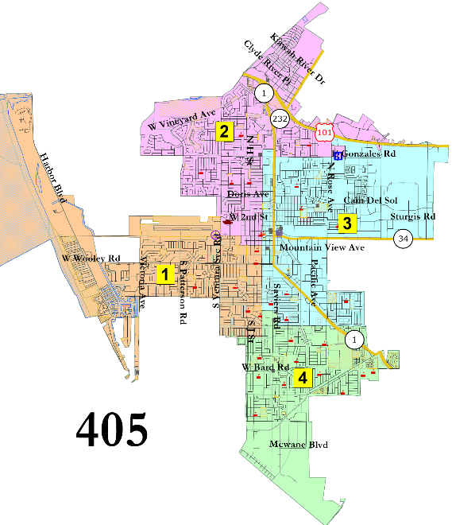
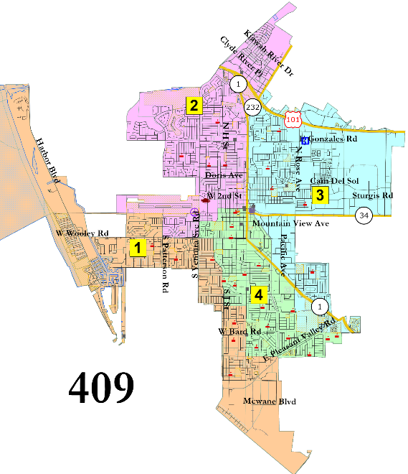
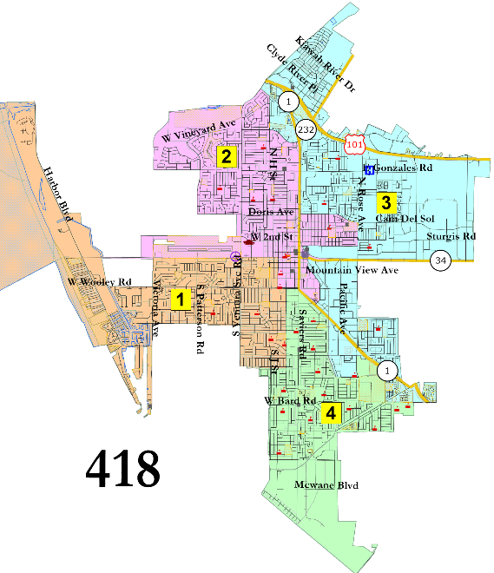
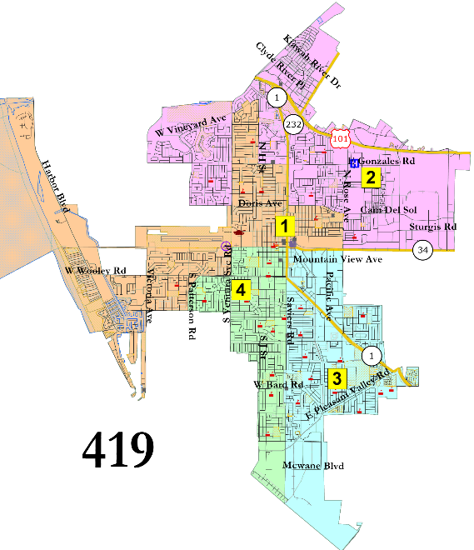
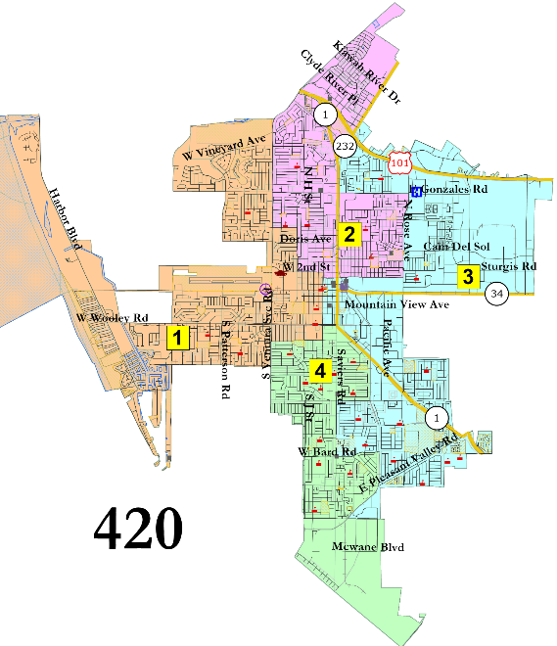
“Jeri Manders” and similar
Interactive Map

Slide 8
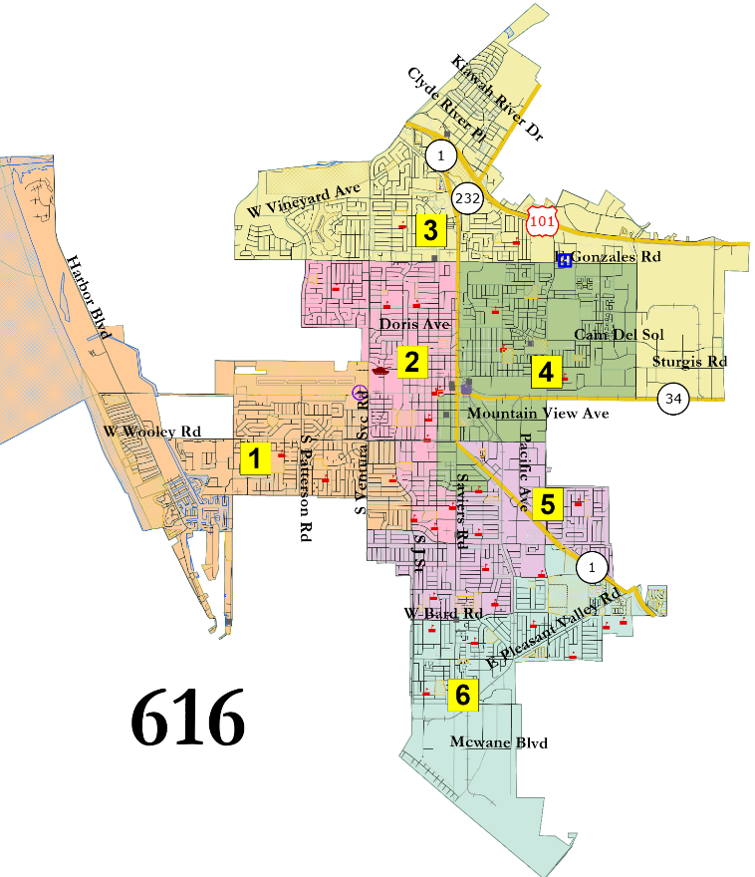
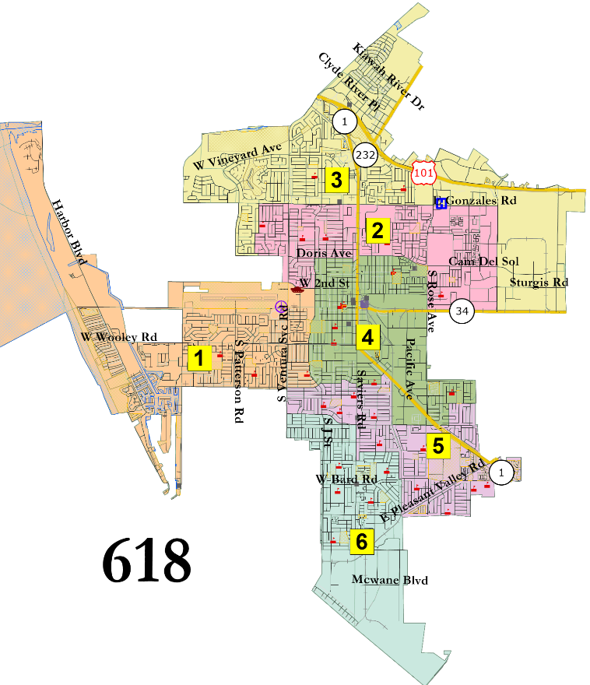
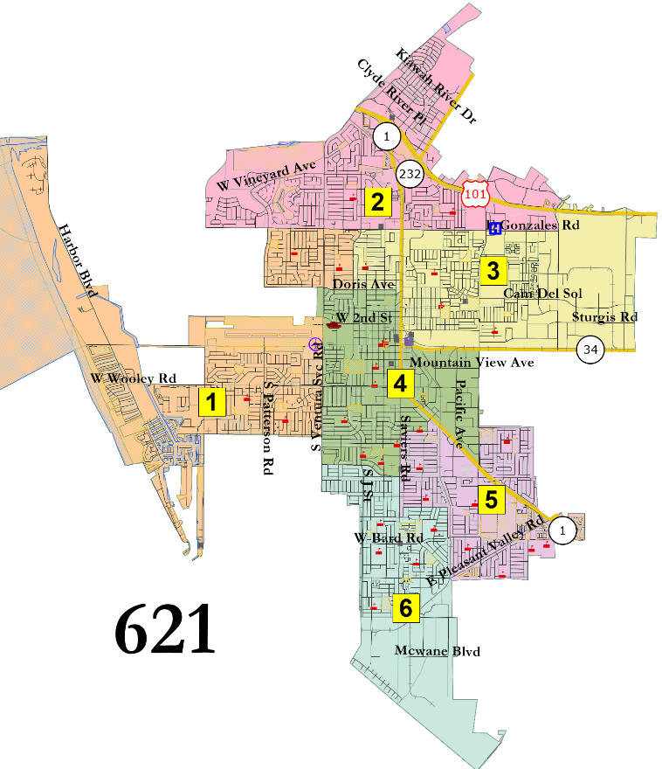
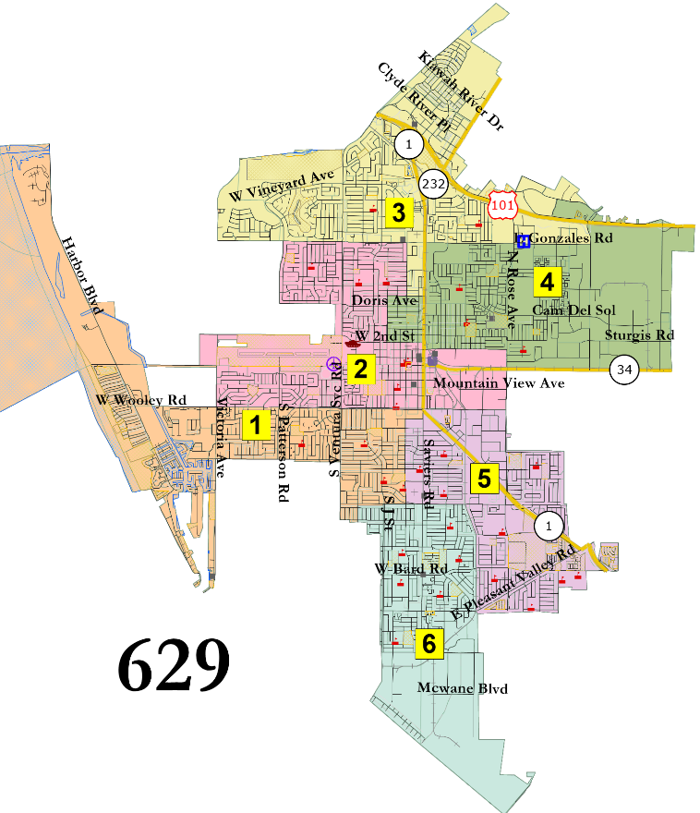
United North
Interactive Map

Slide 9
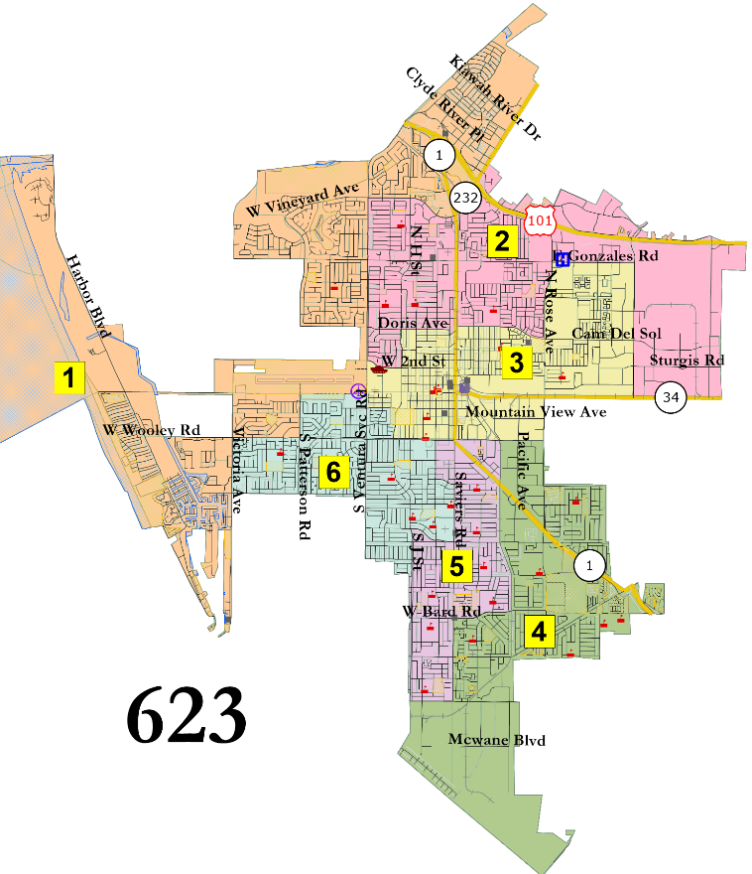
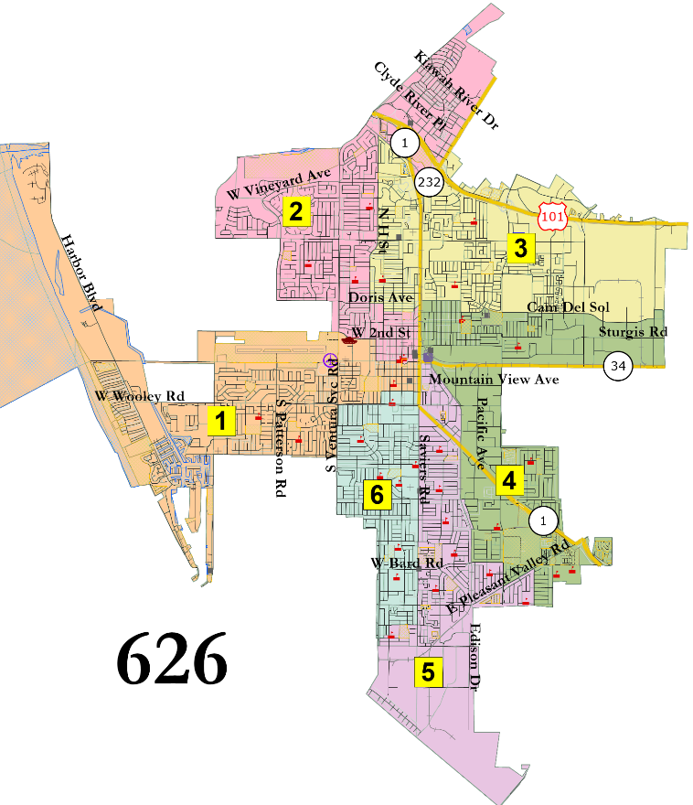
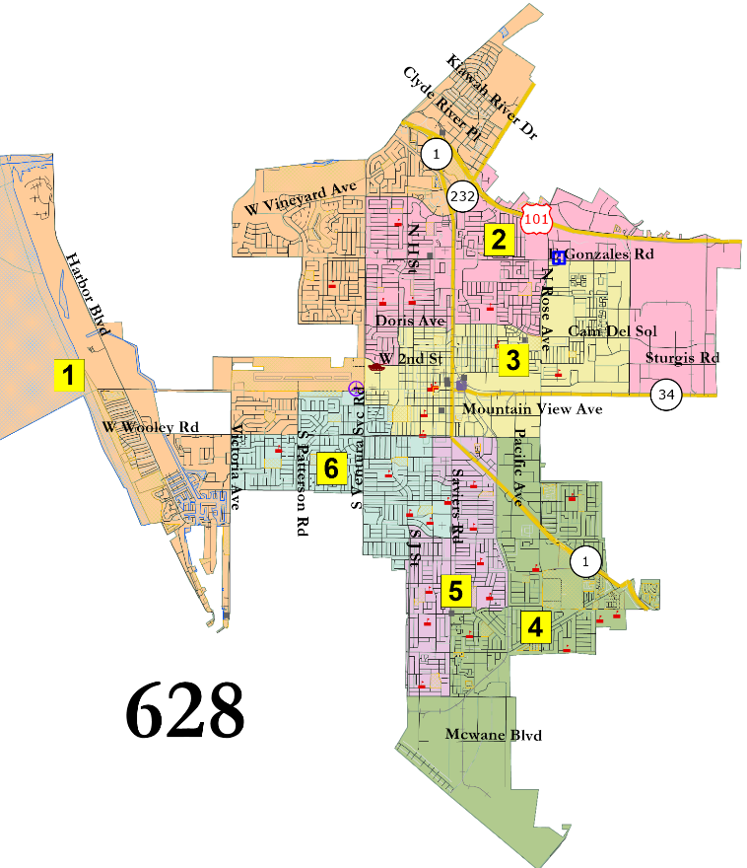
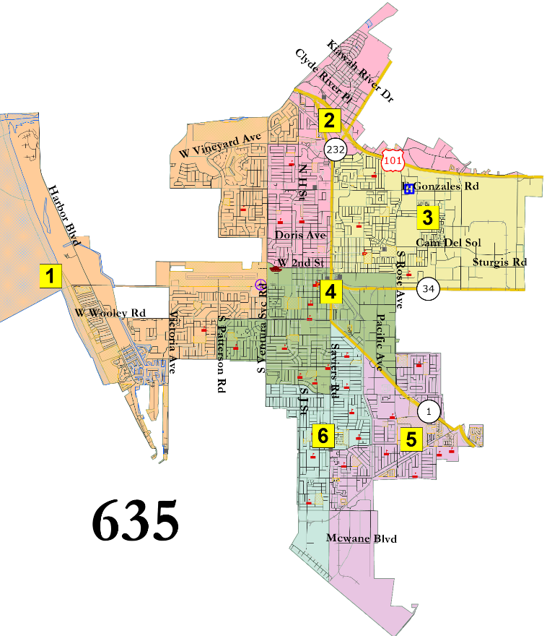
2 districts in far south
Interactive Map

Slide 10
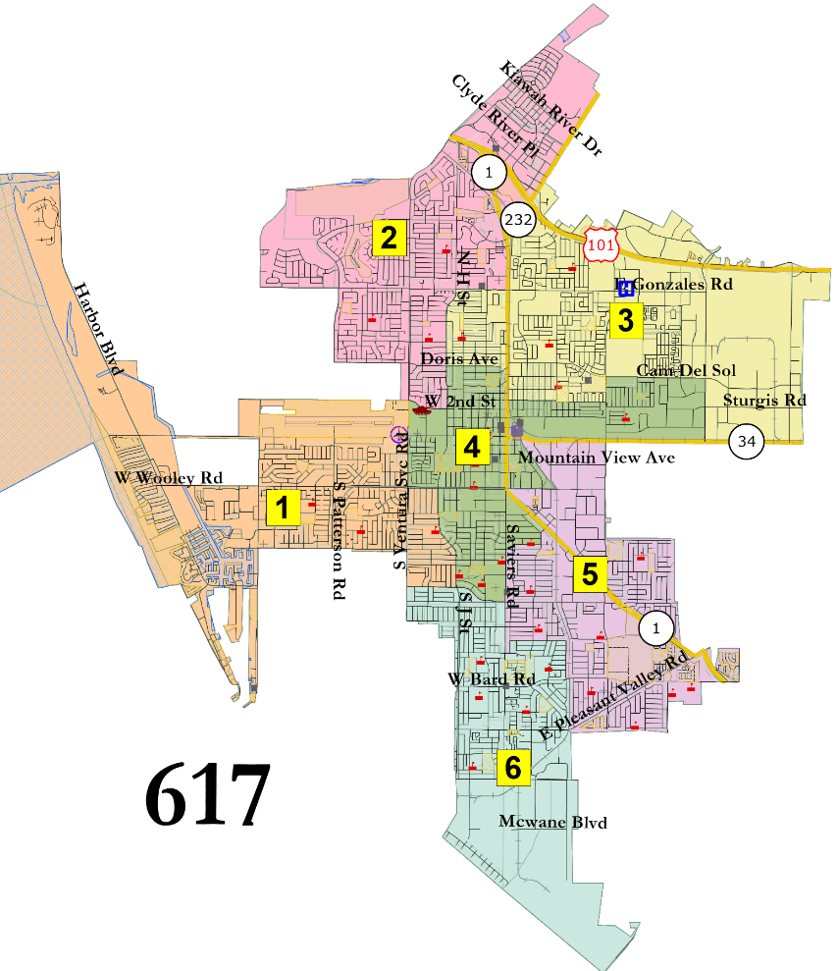
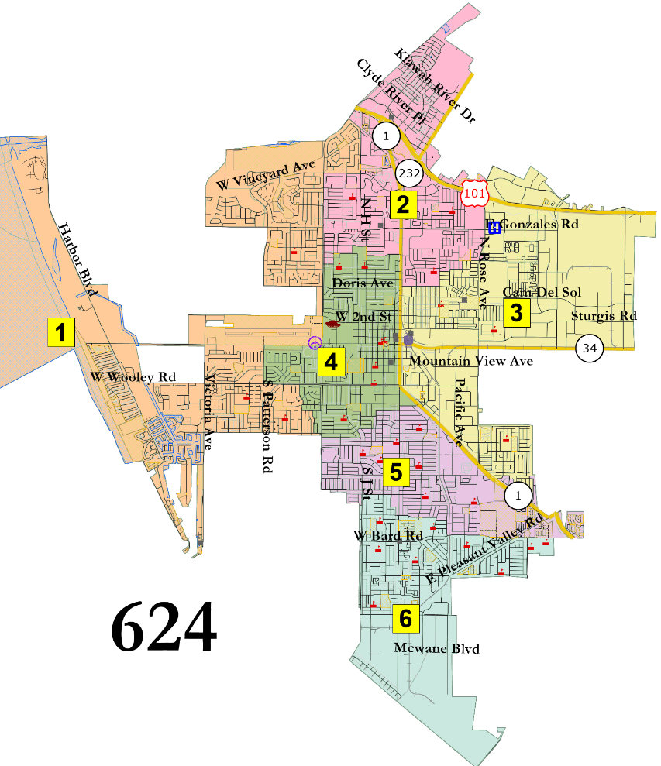
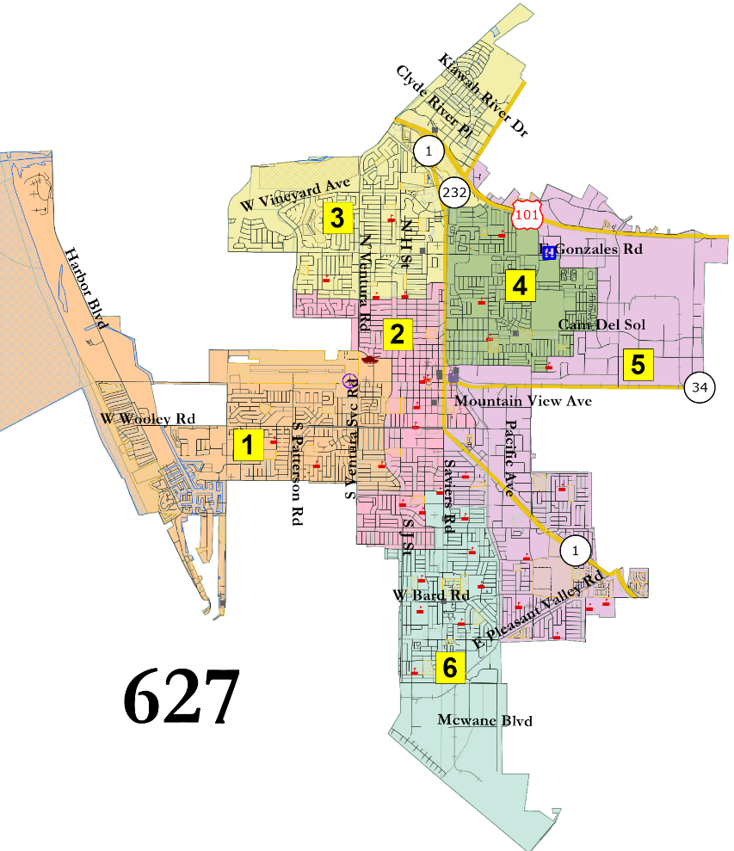
United Center
Interactive Map

Slide 11
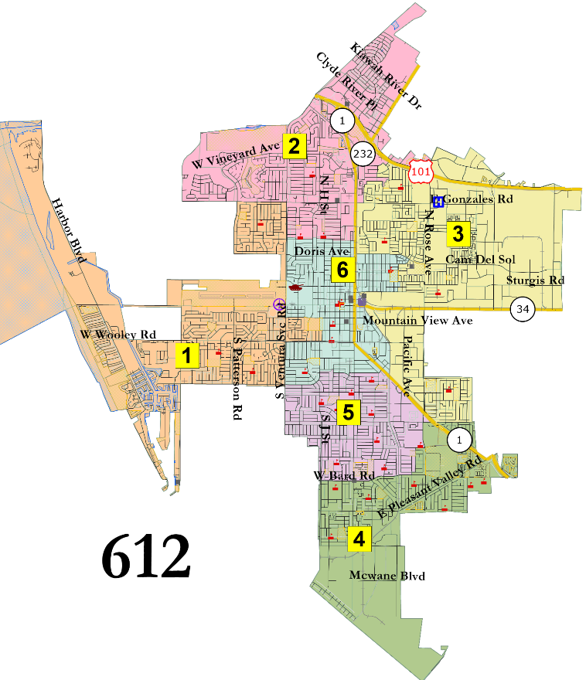
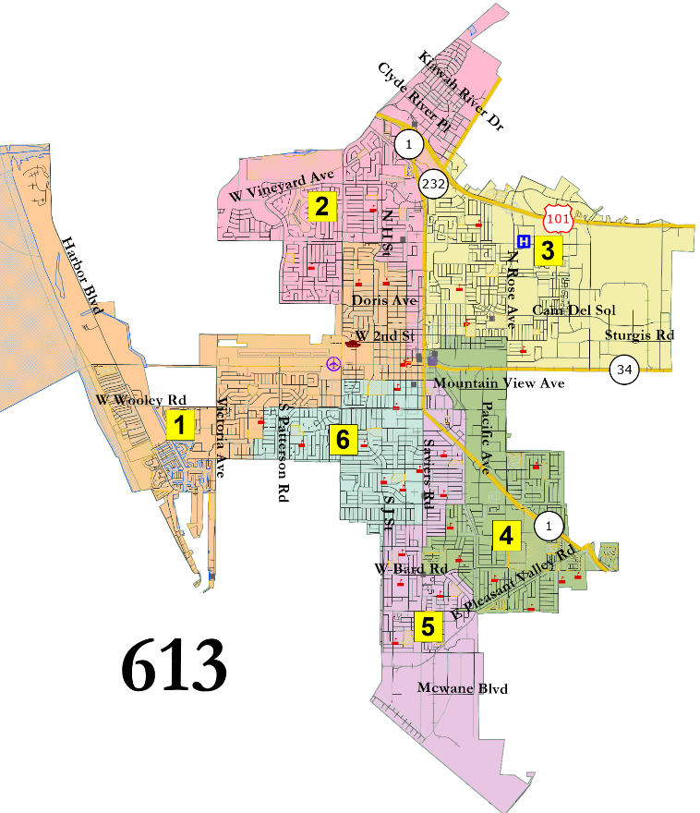
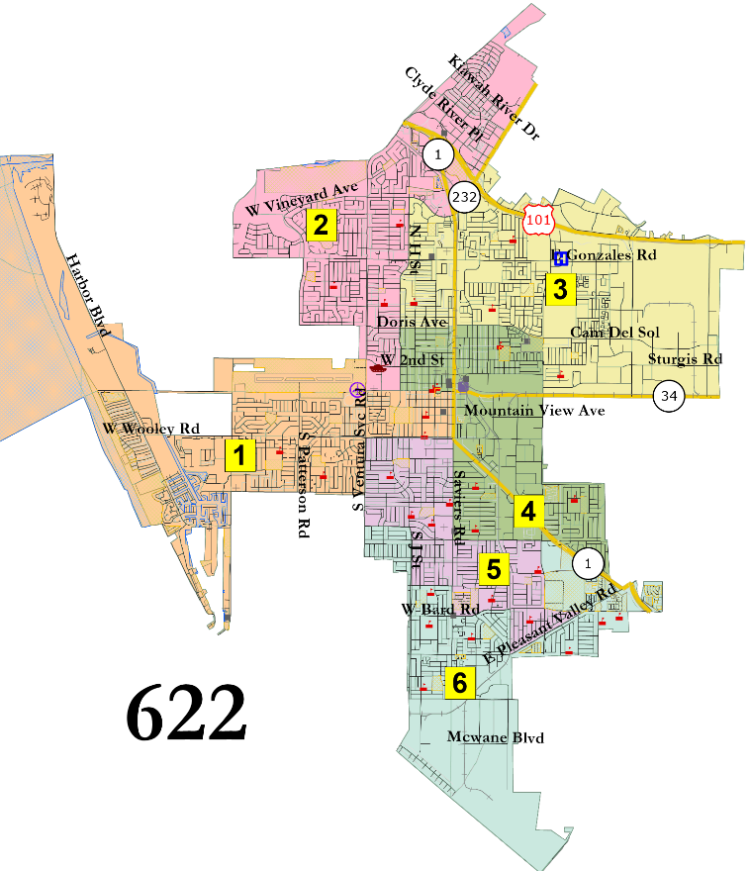
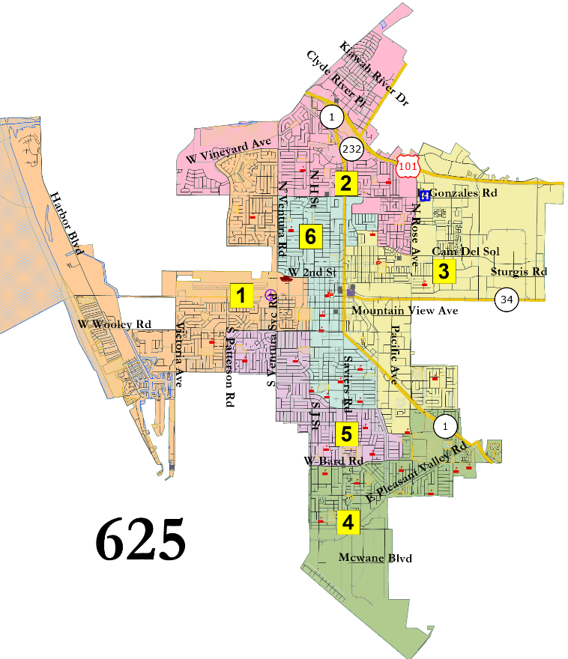
Blended Center
Interactive Map

Slide 12
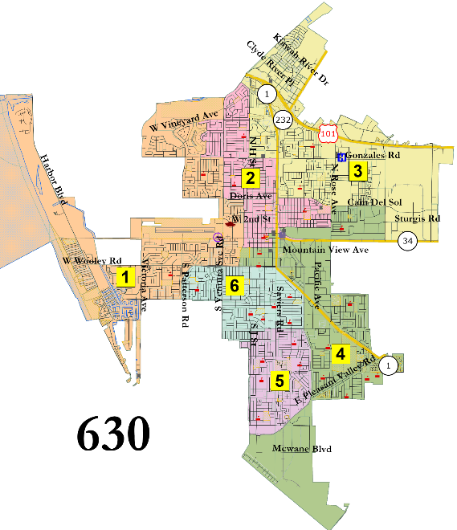
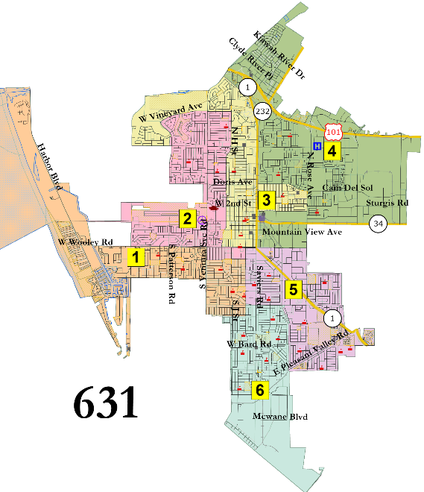
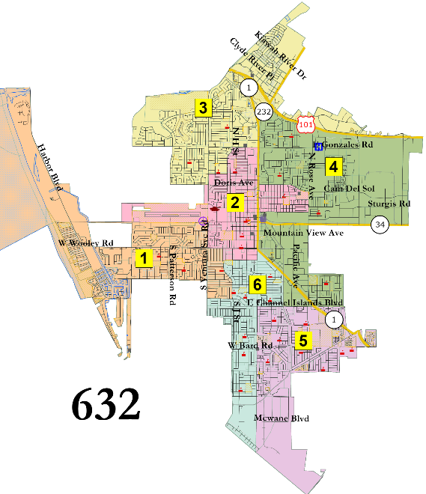
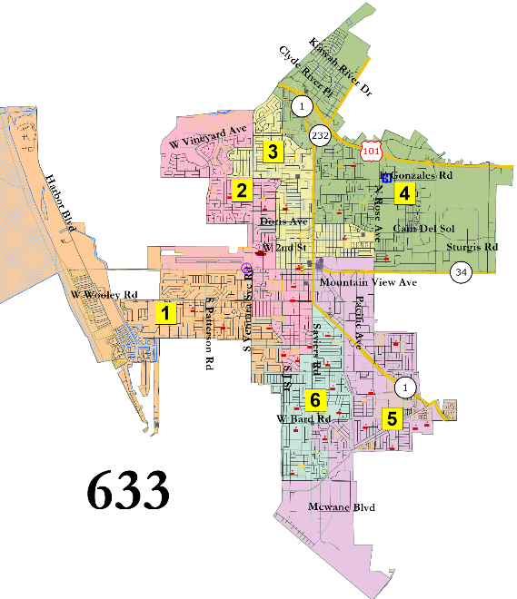
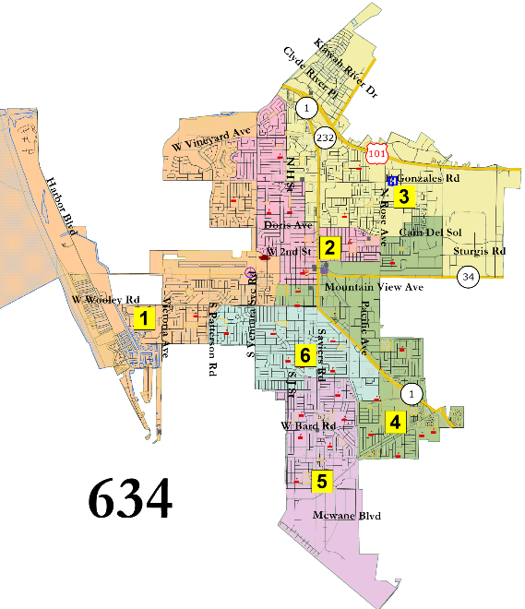
“Jeri Manders” and similar
Interactive Map

Slide 13
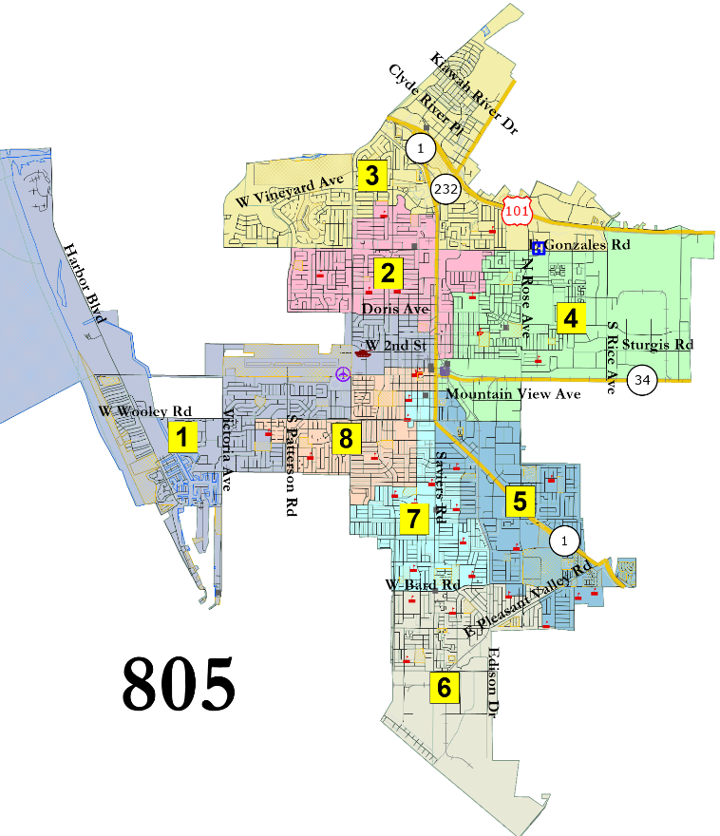
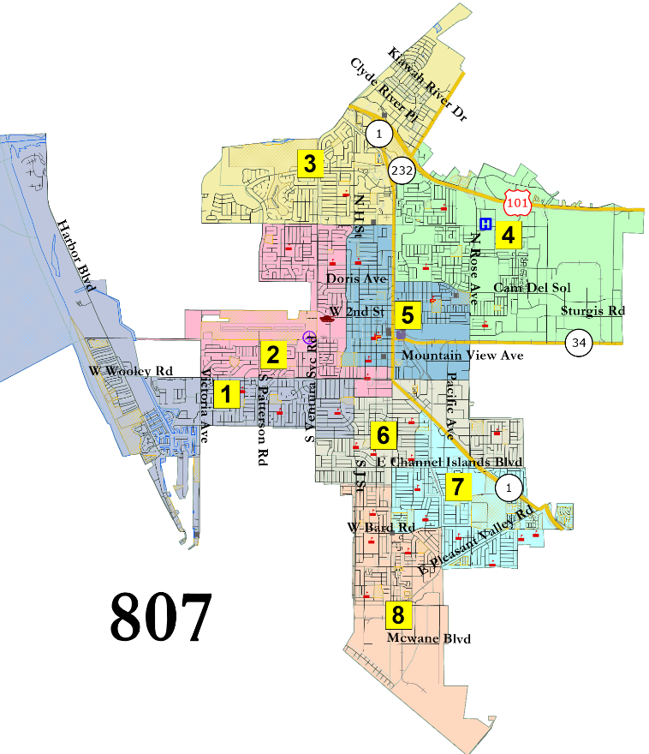
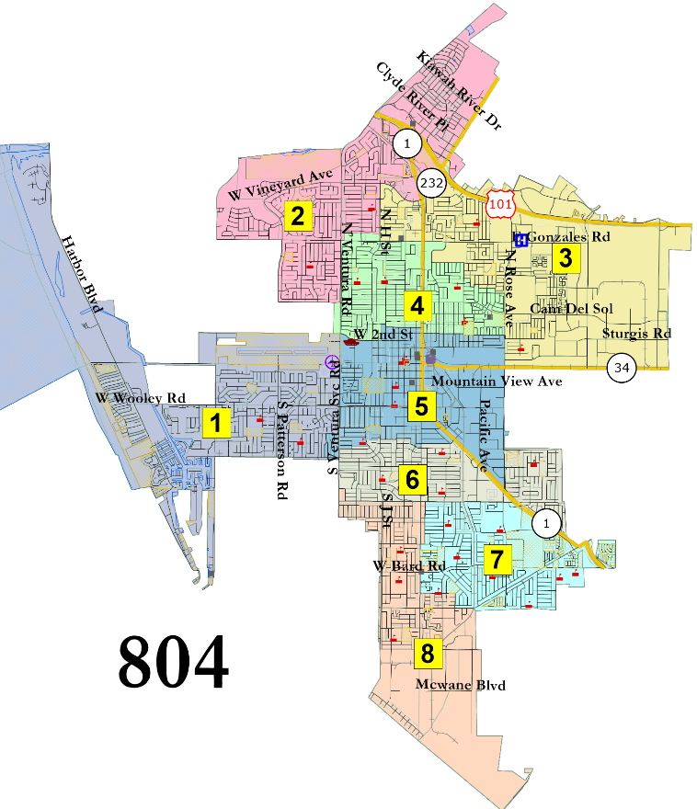
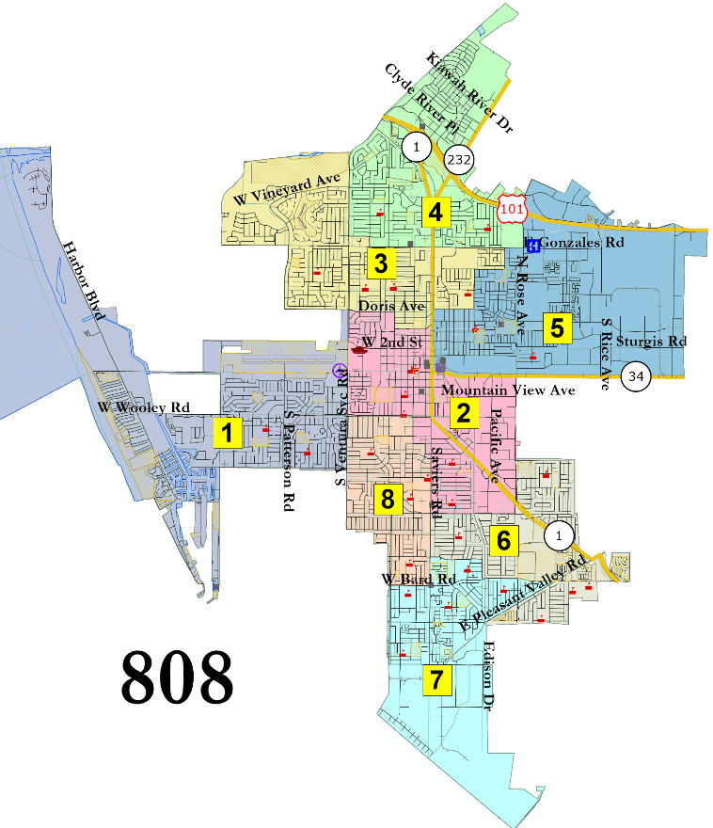
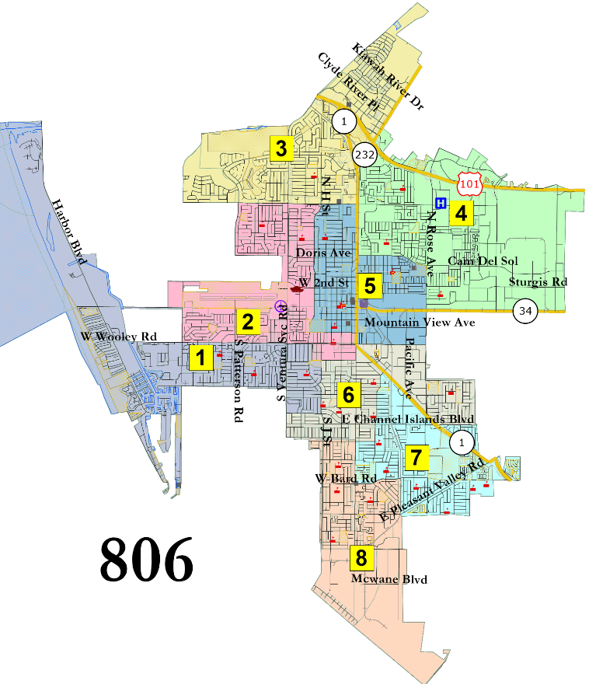
Interactive Map

Slide 14
Summary of Public Comments
Keep Five Points with downtown
Do not divide Five Points along Oxnard Blvd
Issues north of Wooley Rd are “totally different” from issues south of Wooley Rd
Most maps split Wilson neighborhood
621 and 624 keep Wilson united
Maps 624 and 635 divide neighborhoods
621 and 622 are the best mix of north and south representation
635 is the most representative map
Preference for united neighborhoods
Prefers 6-district map
Don’t split Wilson or La Colonia
Auto Center / Esplanade should be divided as it is the city’s economic center
Prefers culture as division more than socio-economics
Central district should span east-west as those areas are culturally linked
624 splits neighborhoods
621, 622 or 635 is best
622 is best
622 splits Five Points from downtown
635 is best, with 623 as 2nd choice (mainly due to 2 districts in South Oxnard)
Likes 621, as it separates industrial and farm areas, follows high school zones, and balances future growth
Draw as many districts as possible in South Oxnard
635 divides city along neighborhood, income, commercial, and other socio-economic boundaries
Wants 8 districts
808 is best map
Prefers 6 districts with two in the south
Maps 403 and 422 should not divide Colonia
Prefers 6 or 8 districts, likes 617, 806 or 807
Prefers not splitting Oxnard College or St Johns Hospital areas

Slide 15
Suggested Action
Decide on preference for 4, 6 or 8 districts
Within the preferred category, select 2 to 4 “focus” maps

