Slide 1
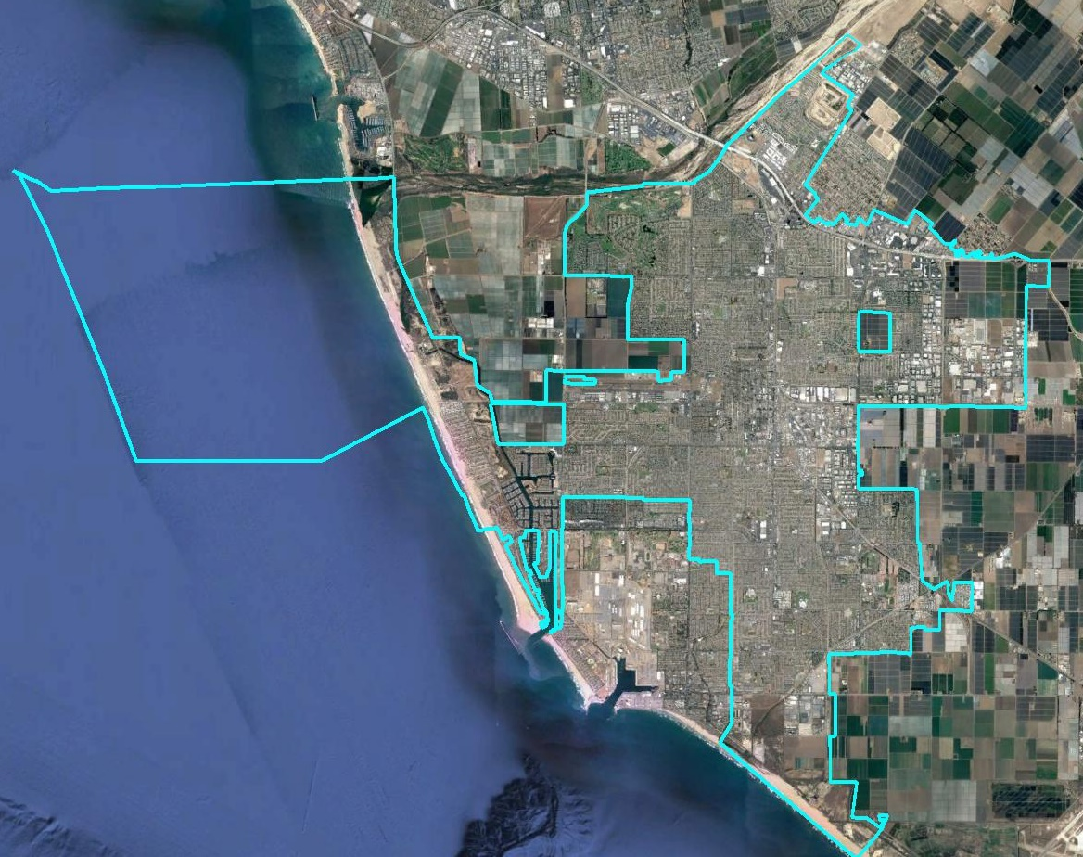
City of Oxnard Consideration of By-District Elections

Slide 2
Traditional Districting Criteria
Federal Laws
Traditional Criteria
Equal Population
Federal Voting Rights Act
No Racial Gerrymandering
Communities of interest
Compact
Contiguous
Visible (Natural & man-made) boundaries
Respect for voters’ wishes and continuity in office

Slide 3
Public Participation
City provided many avenues for public input:
South Oxnard forum
Online districting tool
Excel and paper districting tools
Social media and traditional communications channels
Public Responded:
About 80 participants at South Oxnard forum
72 maps submitted, with 59 drawn using the online tool, 3 using the Excel tool, and 10 using the PDF/paper map
Even counting just one of the 34 maps submitted by one person, and just one of the 10 maps submitted by a 2nd resident, 17 residents submitted 30 maps!

Slide 4
Summary of Maps
72 Maps submitted
7 were withdrawn by the submitter (in favor of updated versions)
7 divided the city into only two or three districts
18 were not population balanced
1 did not contain contiguous districts
1 proposed a single district to be contained in a 6-district map
Legal Maps Submitted
13 four-district maps
20 six-district maps
4 eight-district maps
NDC added an additional 4-district and an additional 8-district map to round out the mix of options

Slide 5
Reviewing the Maps
NDC has grouped the maps into categories based on similar general characteristics
NDC suggests Council, based on public input, identify two to four “focus” maps in each category (four, six and/or eight districts) with which the Council wishes to move ahead
NDC has suggested “focus” maps, but the public is encouraged to offer their own suggestions and NDC encourages changing that list as the community and Council see fit
Interactive Map

Slide 6
Four-District Maps
14 legal maps
3 maps that unite the south in one district and have two districts covering the north
2 maps that unite the north in one district and have two districts covering the south
4 maps that unite the north in one district and unite the south in one district
5 maps where the author’s only declared purpose is use this process to remove the voters’ elected council from office

Slide 7
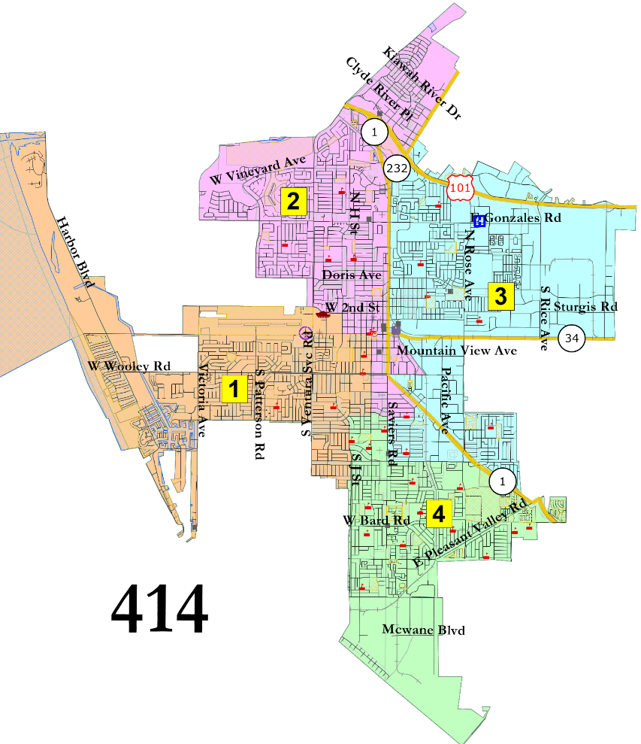
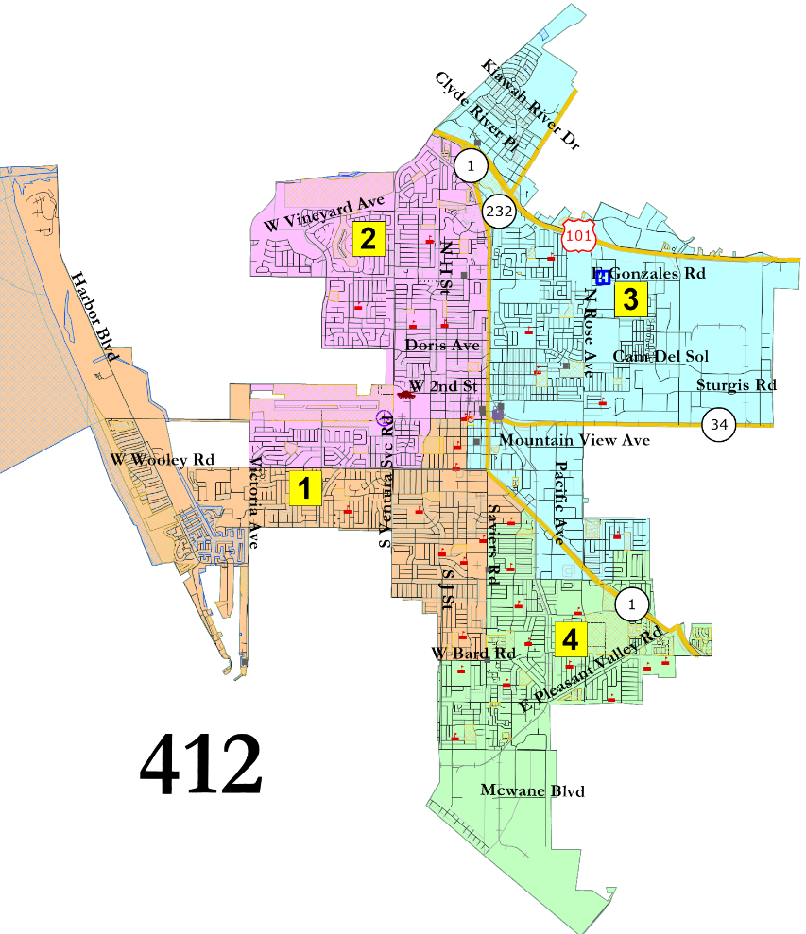
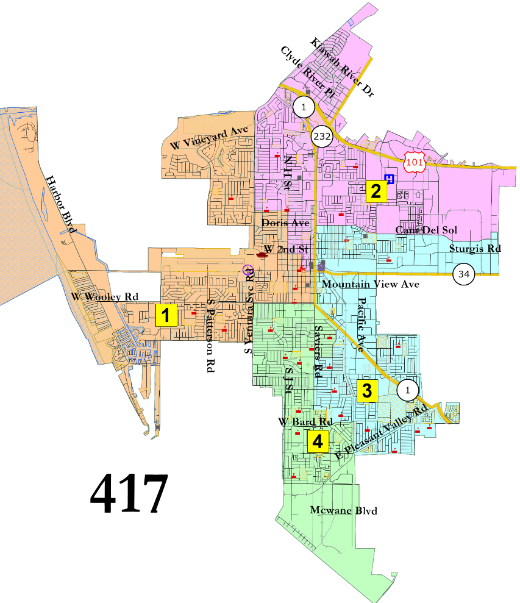
2 Districts in the North
Interactive Map

Slide 8
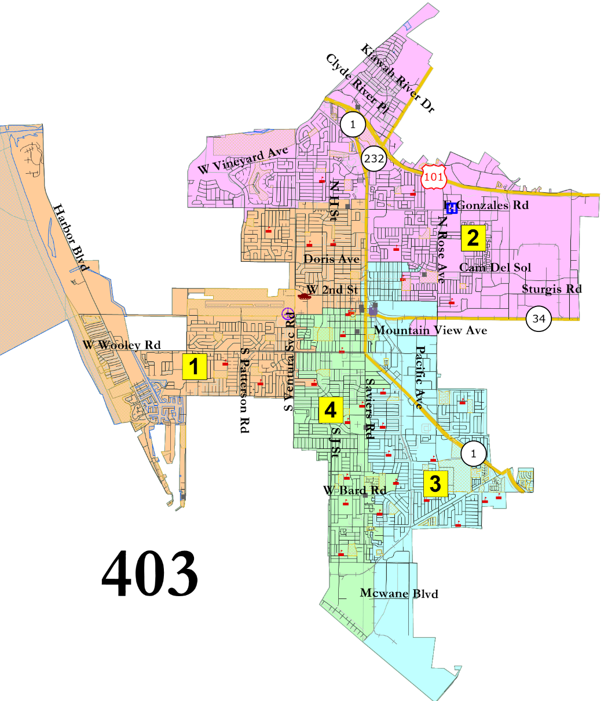
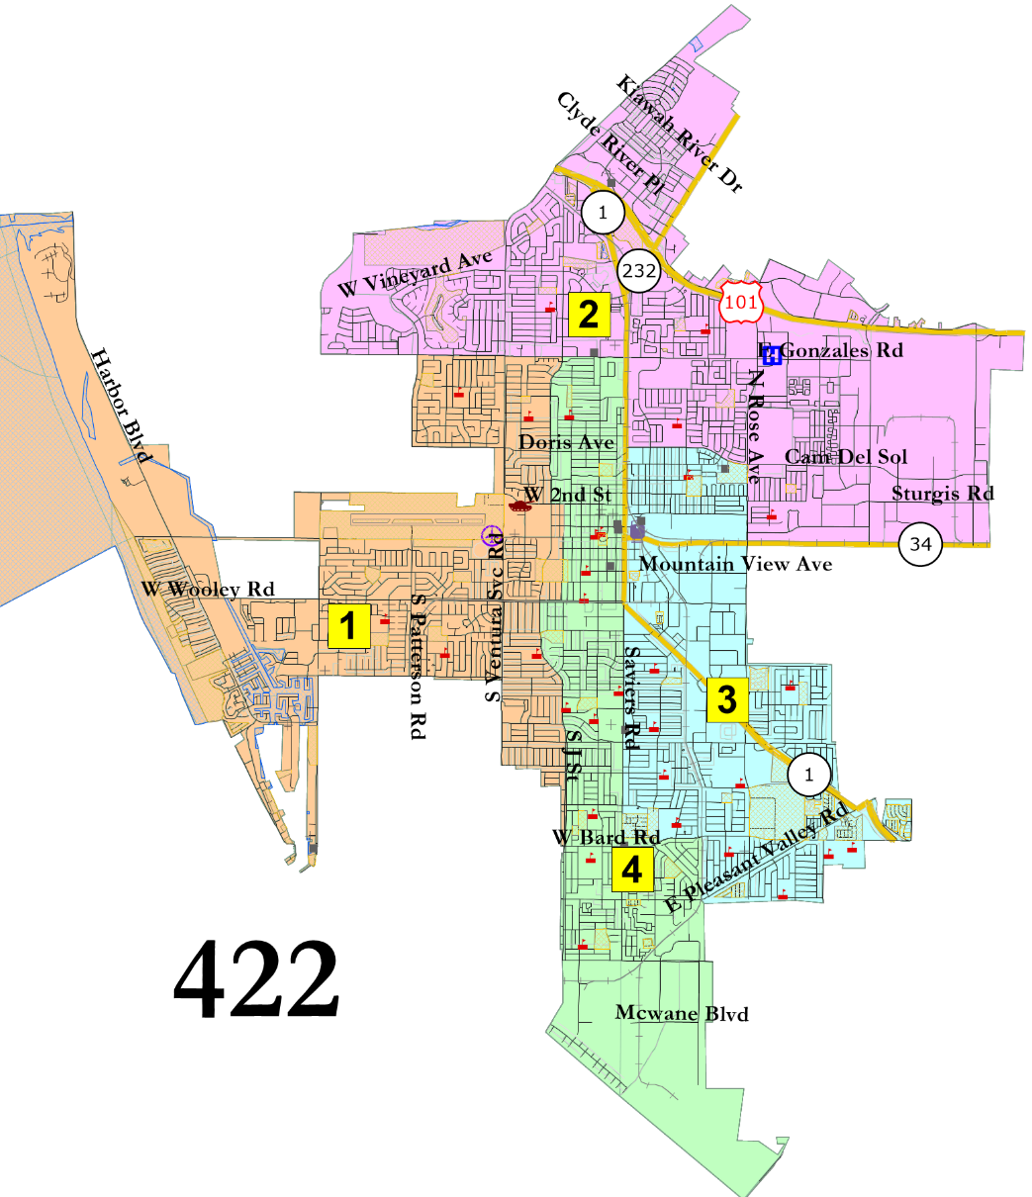
1 in North and 2 in South
Interactive Map

Slide 9
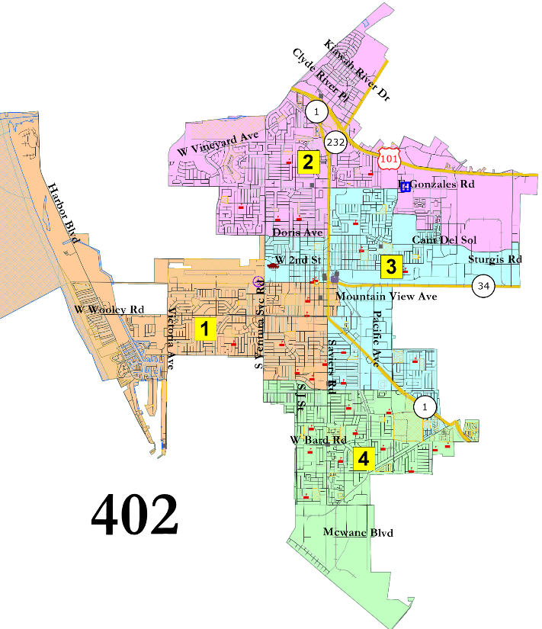
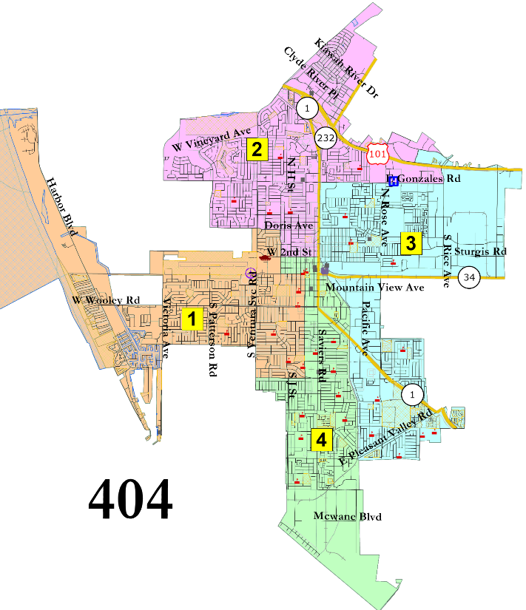
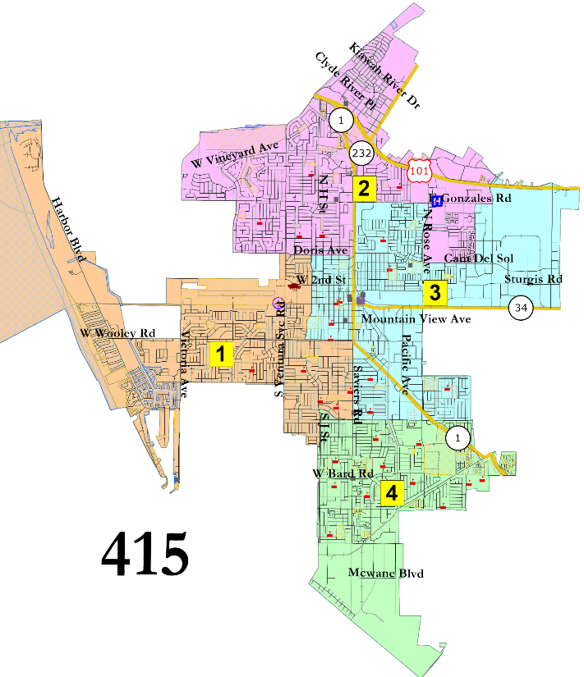
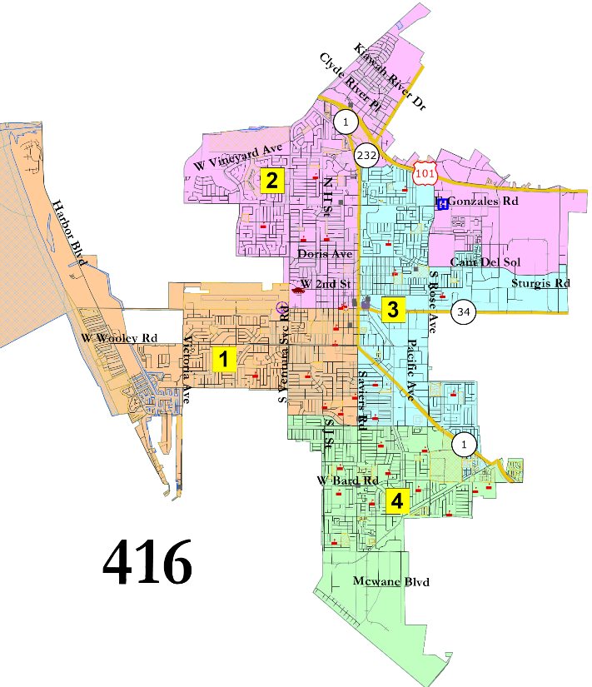
1 in North, 1 in South
Interactive Map

Slide 10
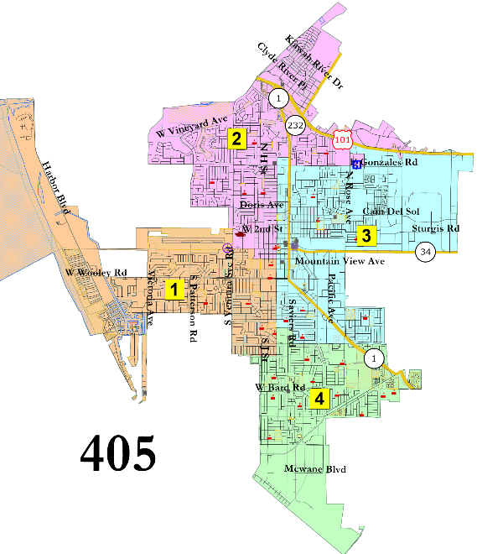
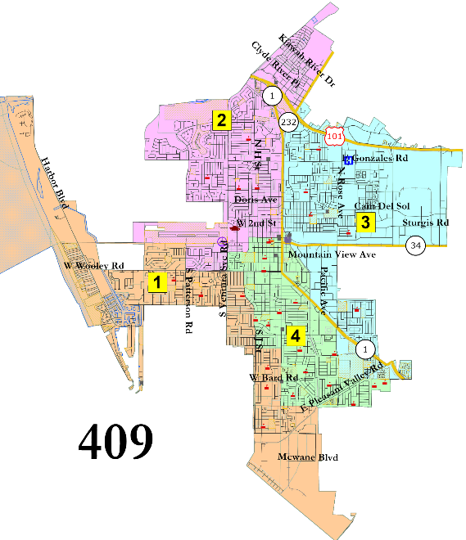
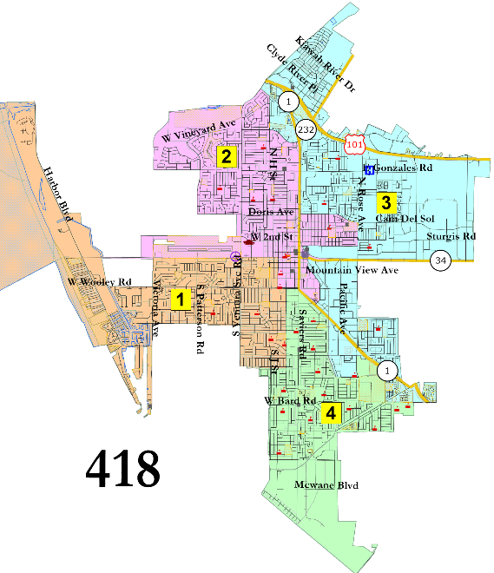
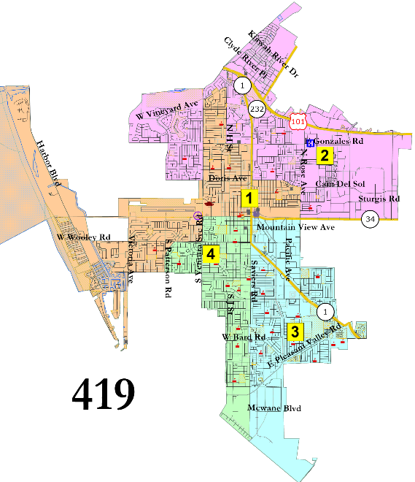
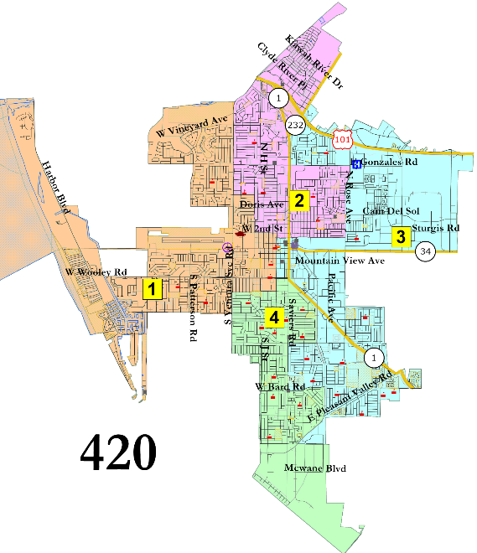
“Jeri Manders” and similar
Interactive Map

Slide 11
Suggested 4-District Focus Maps
Interactive Map

Slide 12
Six-District Maps
20 legal maps
4 maps that unite the northernmost part of the city in a single district
4 maps that have two districts covering the southernmost part of the city
3 maps that unite the center of the city in one district
4 maps that have at least three districts covering the center of the city
5 maps where the author’s only declared purpose is use this process to remove the voters’ elected council from office

Slide 13
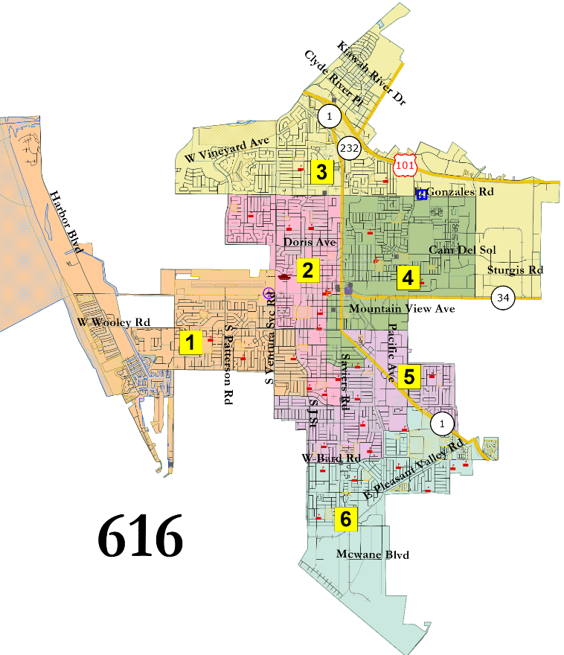
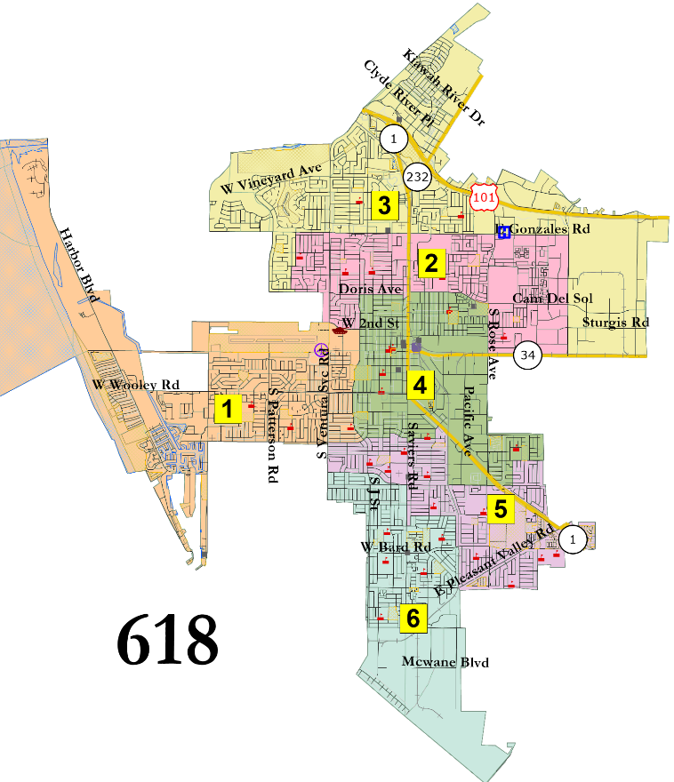
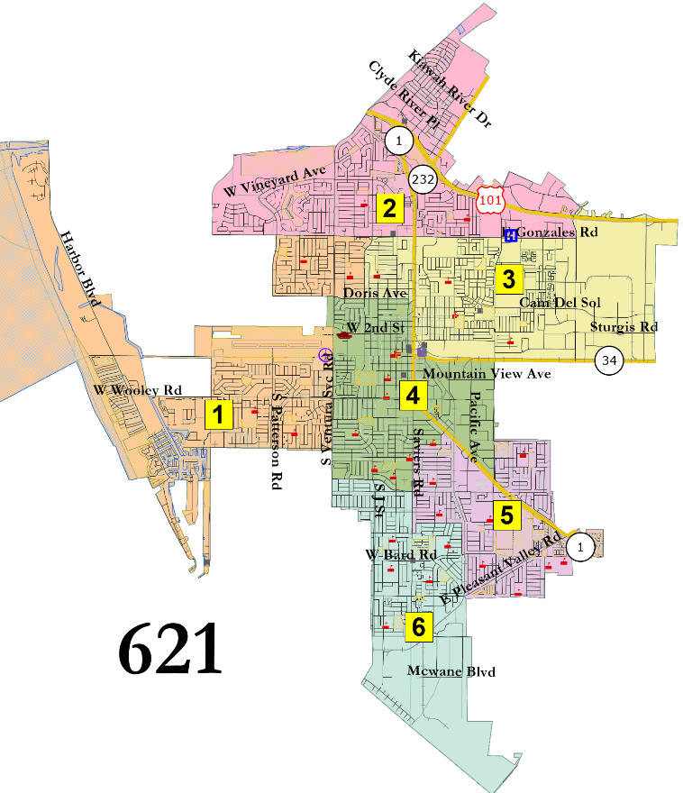
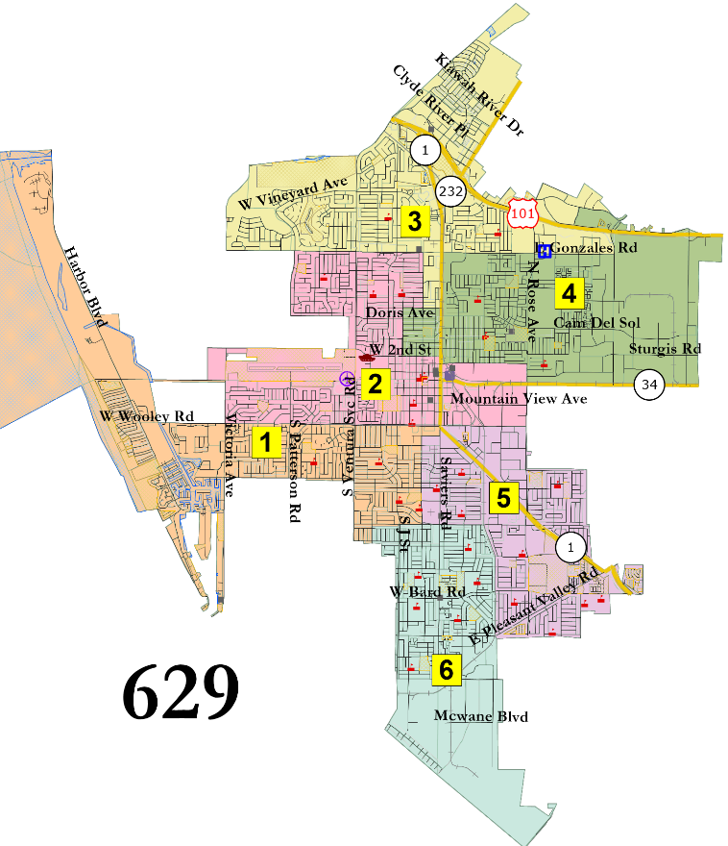
United North
Interactive Map

Slide 14
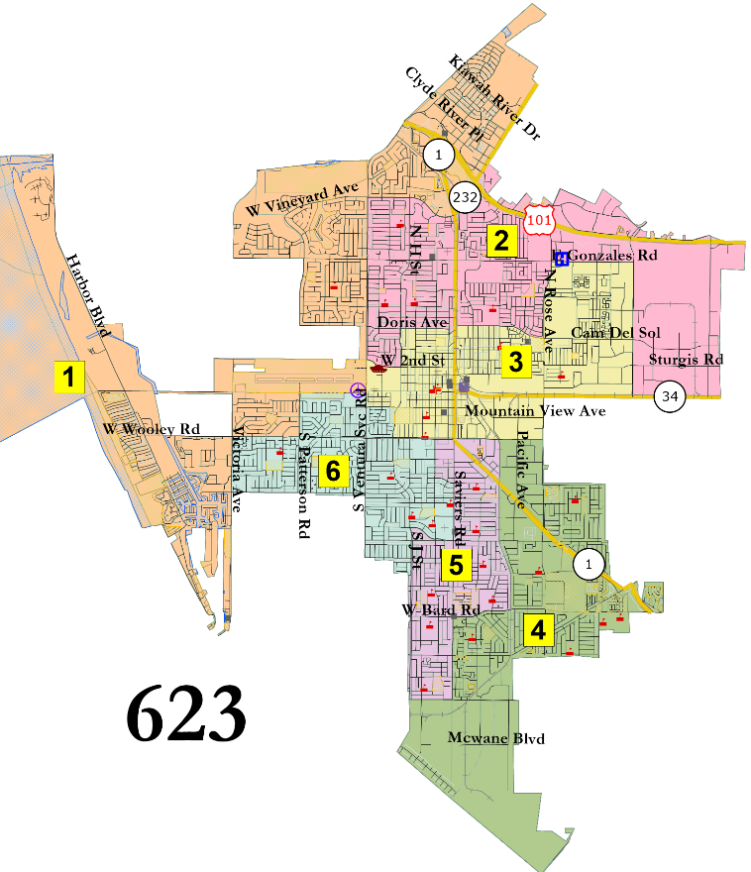
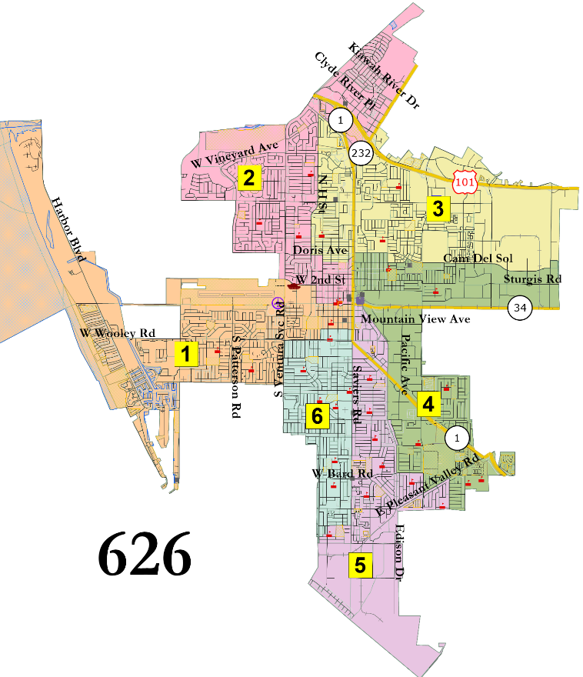
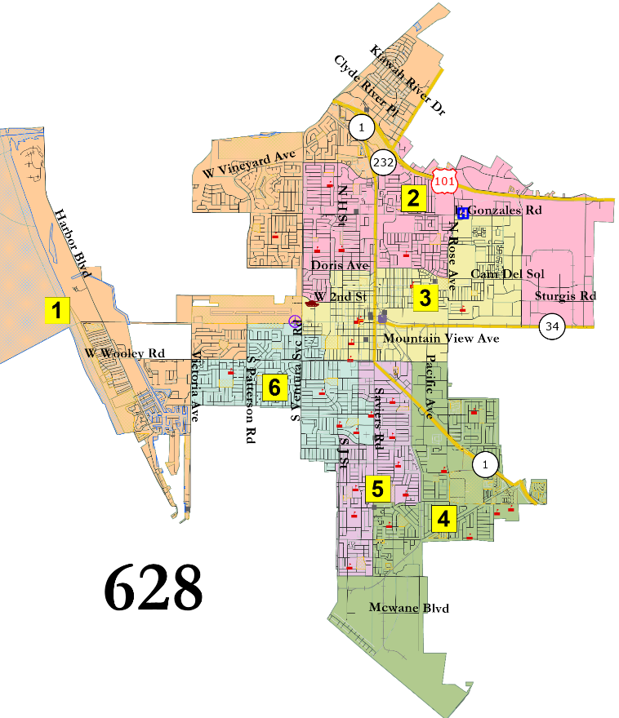
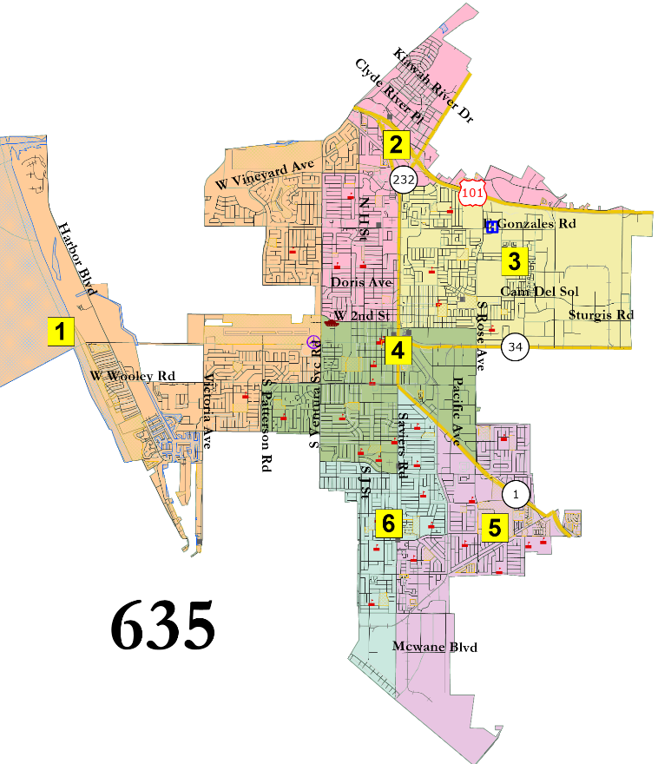
2 districts in far south
Interactive Map

Slide 15
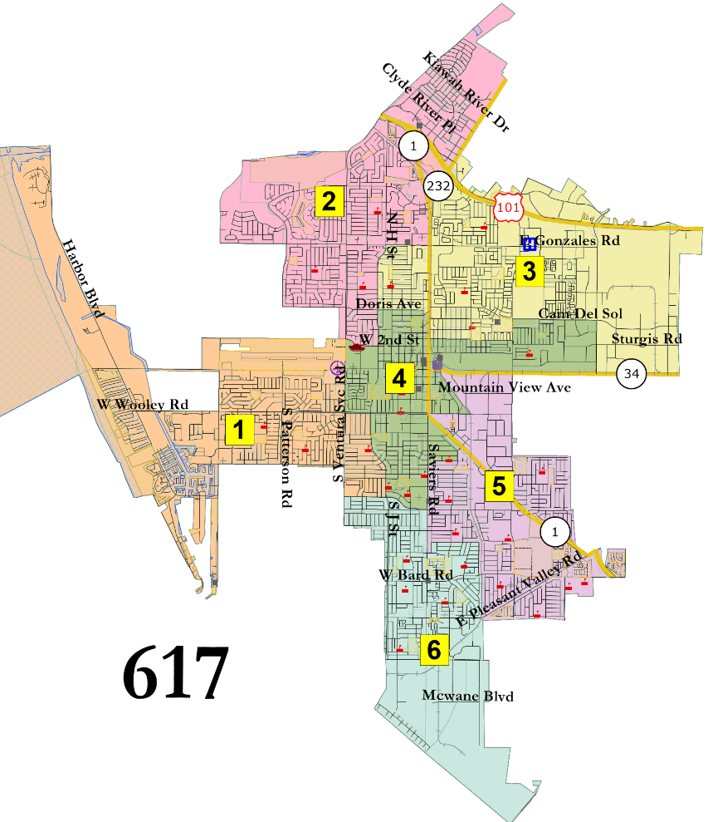
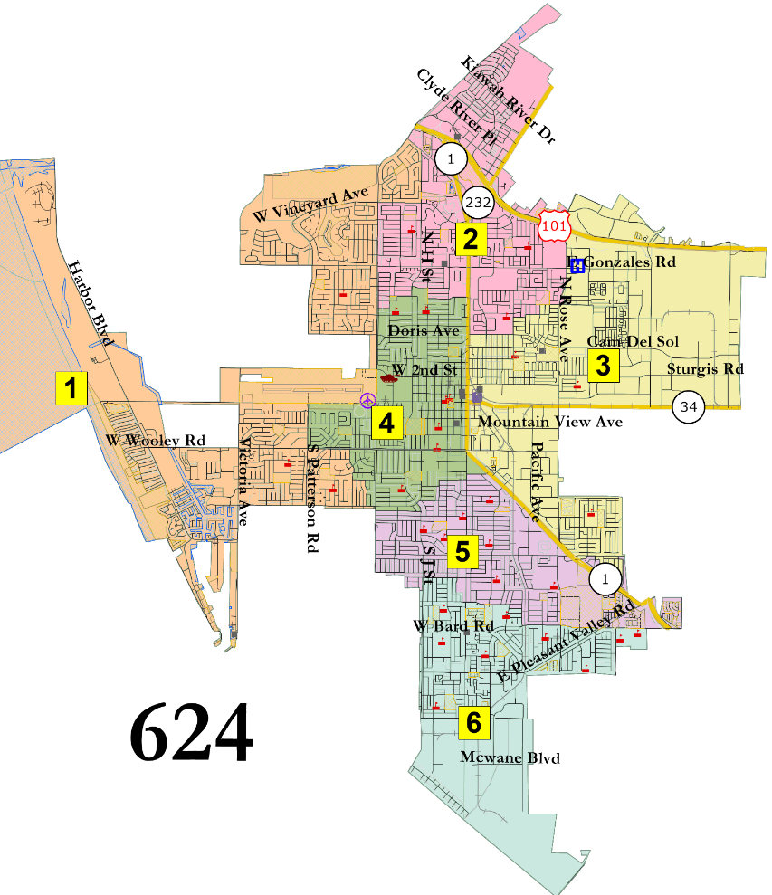
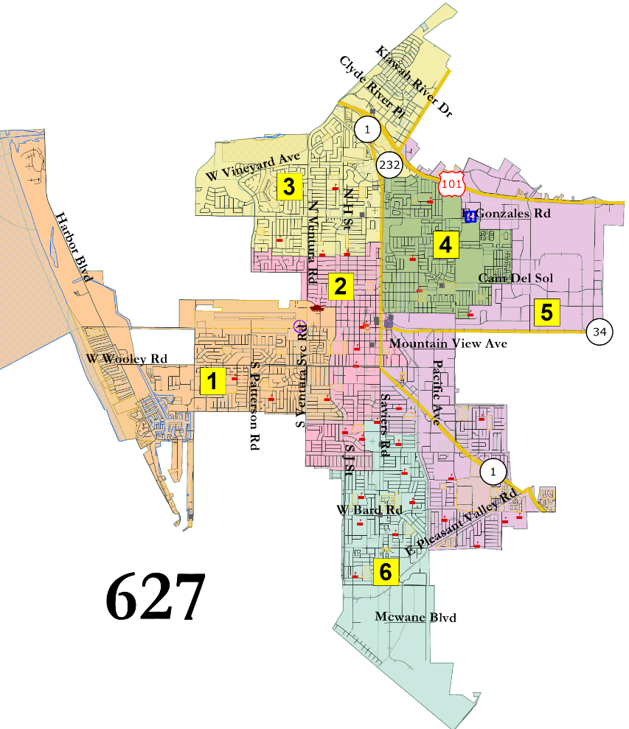
United Center
Interactive Map

Slide 16
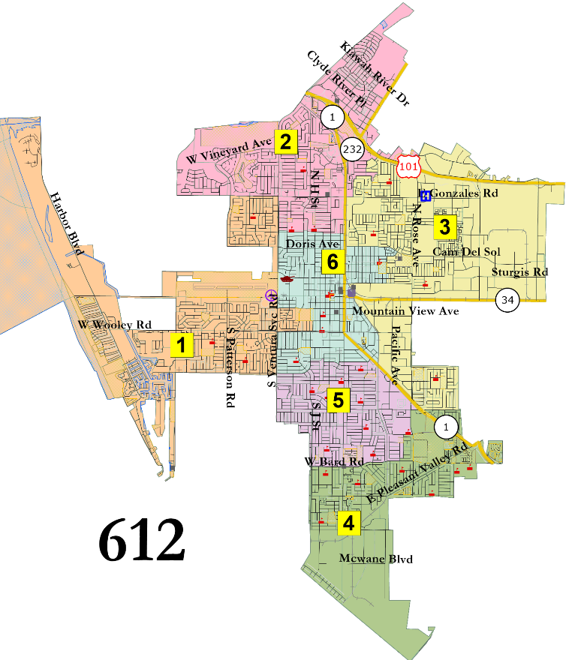
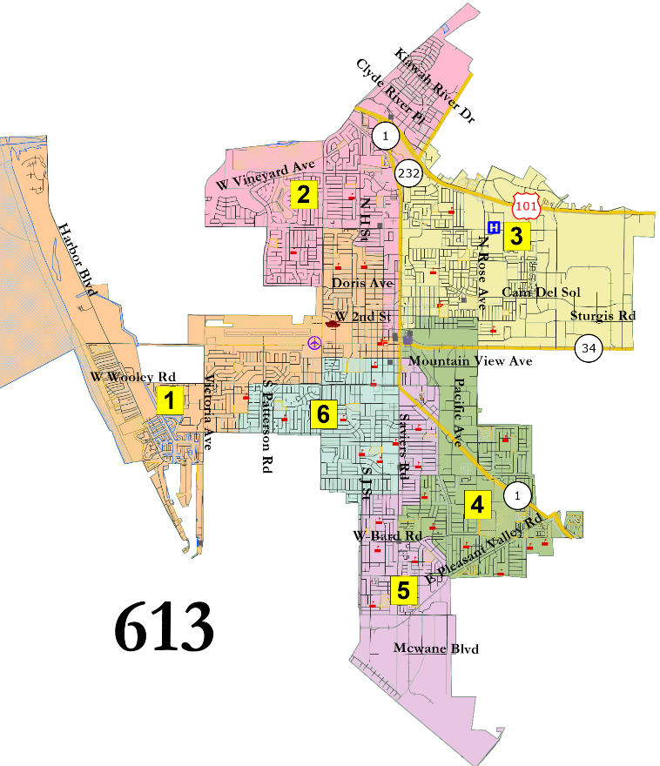
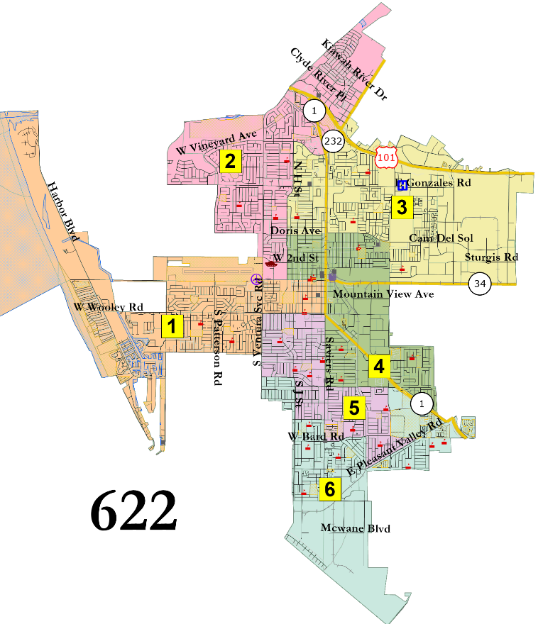
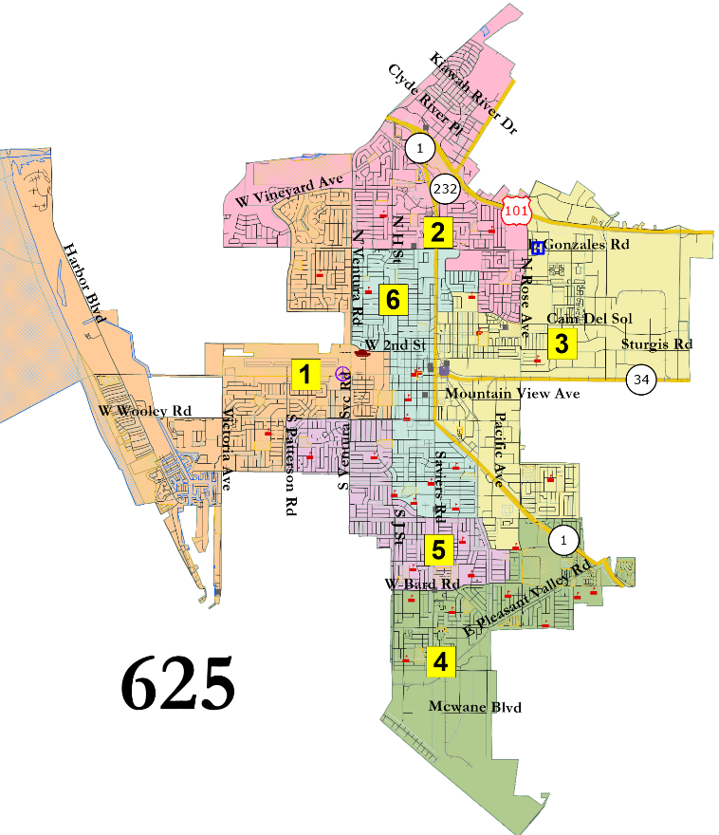
Blended Center
Interactive Map

Slide 17
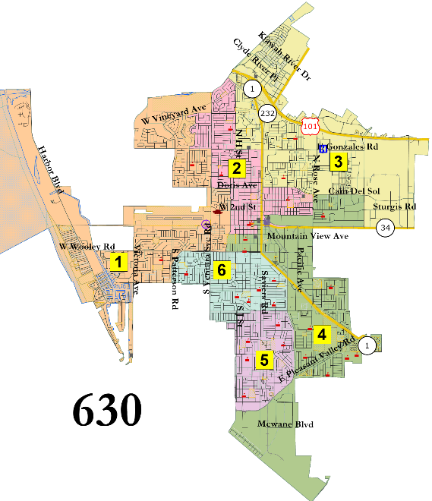
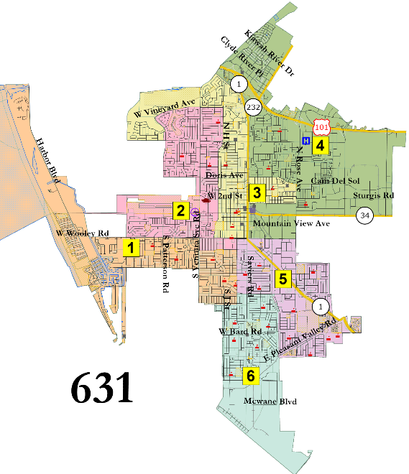
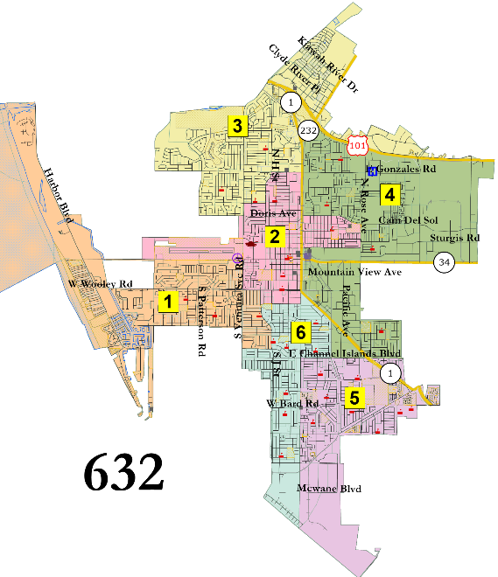
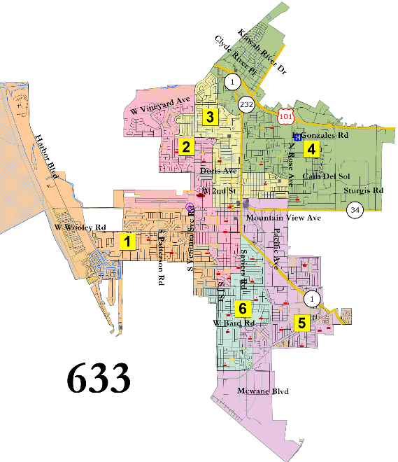
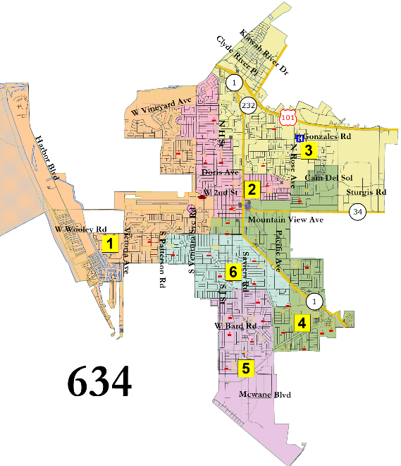
“Jeri Manders” and similar
Interactive Map

Slide 18
Suggested 6-District Focus Maps
Interactive Map

Slide 19
Eight-District Maps
5 legal maps
Geographic configurations vary significantly
All have 7 majority-Latino districts (by CVAP)
Number of 65%-plus Latino districts vary from 2 to 4
Two maps (806 and 807) are intentionally configured to put 3 of the 4 Councilmembers in a single district, and contain only two districts where Latinos are 65% or more of CVAP

Slide 20
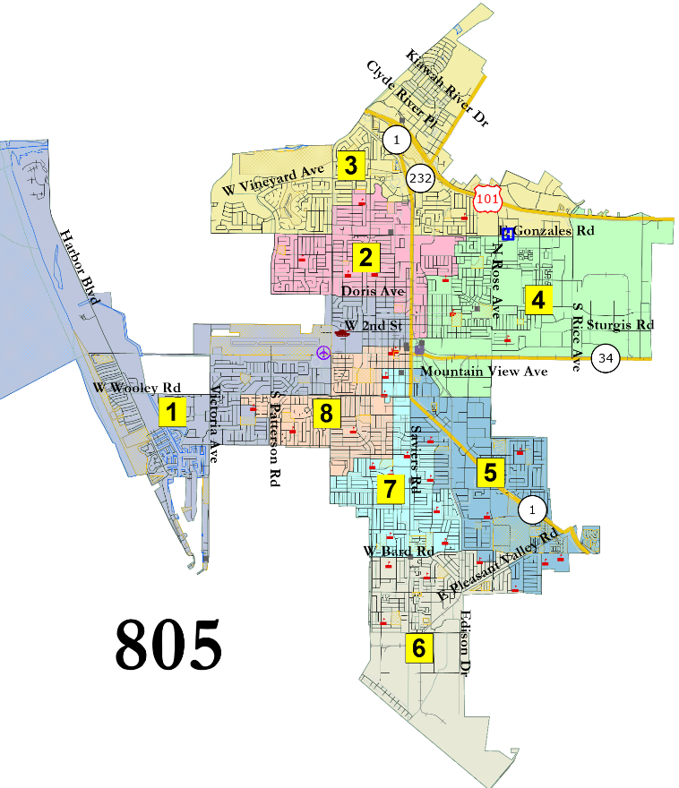
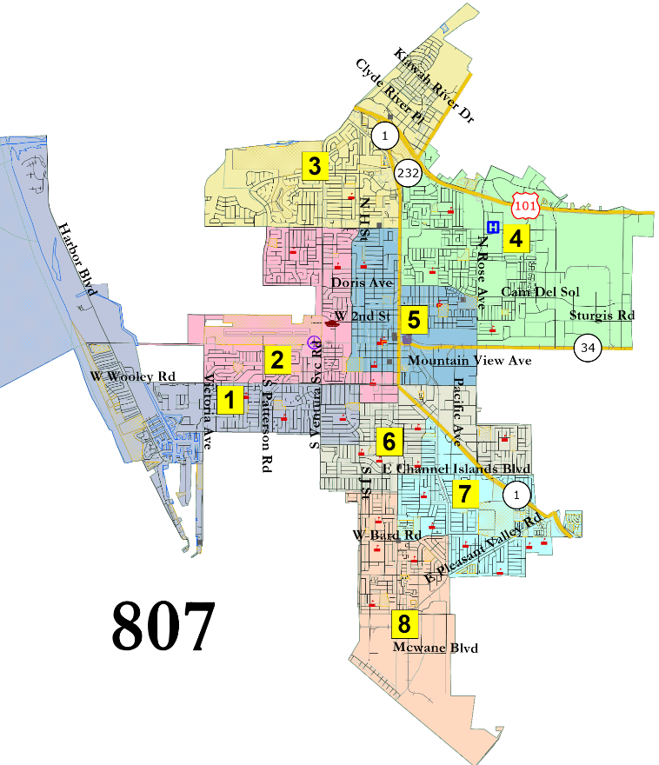
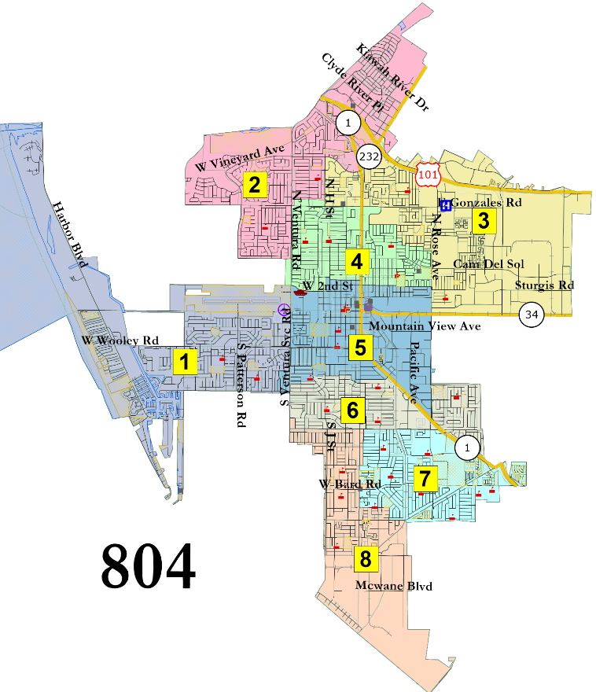
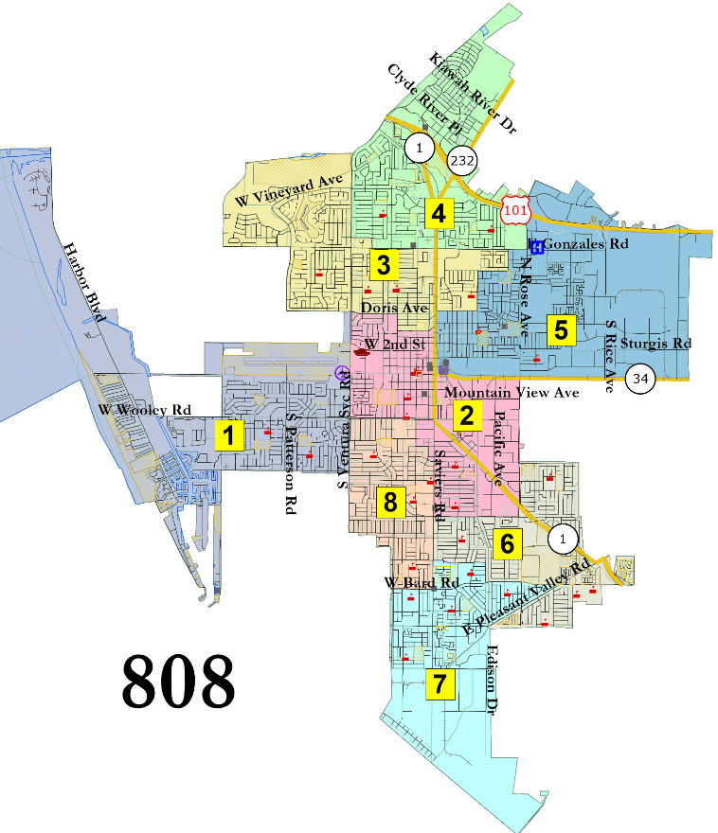
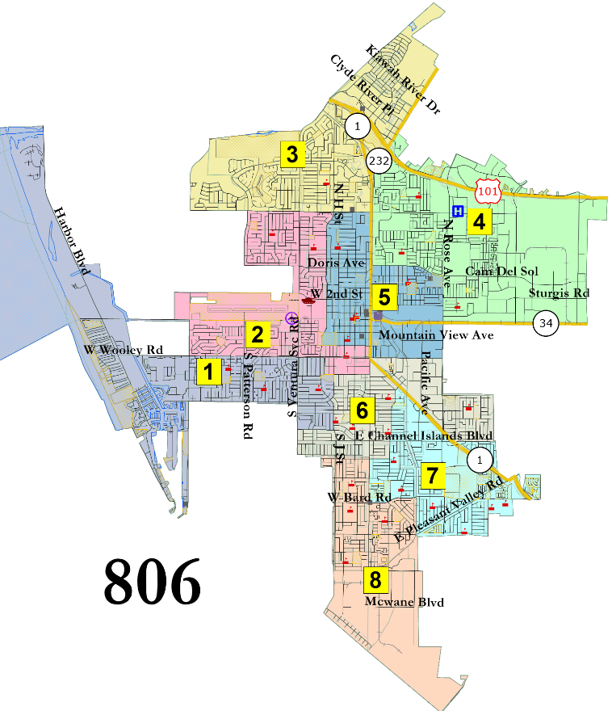
Interactive Map

Slide 21
Suggested 8-District Focus Maps
Interactive Map

Slide 22
Summary
Suggested Focus Maps from Each Group
Four-District Maps Categories:
2 Districts in North
1 District in North and 2 Districts in South
1 District in North and 1 District in South
Six-District Map Categories:
United far North
2 Districts in far South
United Center
Blended Center
Eight-District Maps:
Two maps suggested as “Focus”

Slide 23
Suggested 4-District Focus Maps
Interactive Map

Slide 24
Suggested 6-District Focus Maps
Interactive Map

Slide 25
Suggested 8-District Focus Maps
Interactive Map

